Slide 1
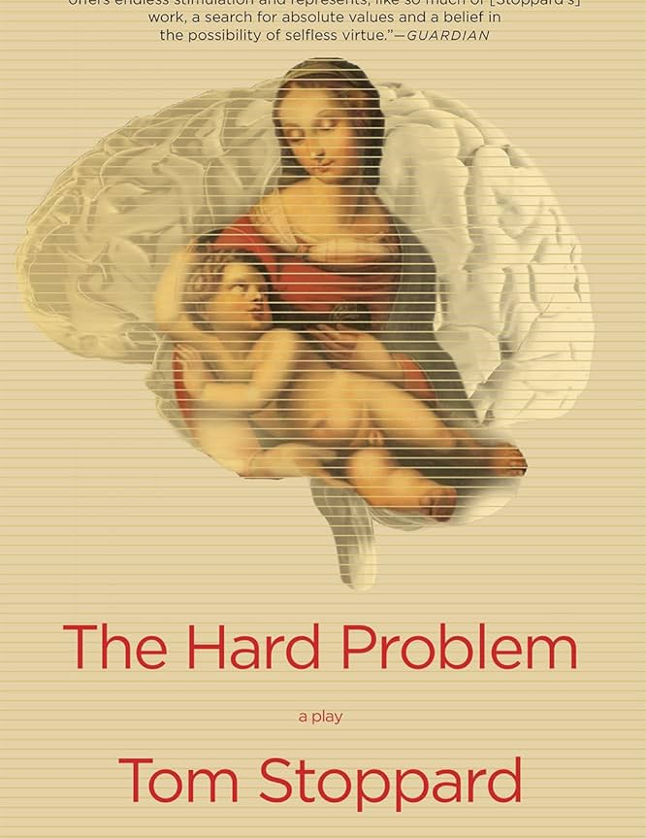

Thought and Calculation: Examining Tom Stoppard’s Theatrical Invention in 3 Plays: The Hard Problem
Session 4
October 29, 2025
1:30 – 3:30 PM

Slide 2

Our 3rd Was Stoppard’s 31st Play
And one that received a hostile critical response
It was his first stage play in nine years

Slide 3
Who? Our Players Are Diverse In Many Ways
Hilary: Initially 22, later 28 in the show. Gave up her child for adoption after becoming pregnant at 15, a decision which still haunts her. Hilary is a psychologist preoccupied with morality, altruism, and other philosophical questions which she is determined to explore beyond the accepted answers
Spike: Initially Hilary’s tutor, later her lover. Very rational and stubborn, always willing to argue his point.
Amal: Indian, Hilary’s age. Often rude; thinks he knows more than the people around him.
Leo: Member of the Krohl Institute. Imaginative and ambitious, determined to be a pioneer in his field. In love with Hilary.
Julia: Went to high school with Hilary. Ursula’s partner. Pilates instructor. Good-natured, caring.
Ursula: Works at Krohl Institute. Julia’s partner. Gruff and often snide, but protective of those she cares about.
Jerry: Head of Krohl Institute. Confident, primarily concerned with his company’s success and his own, which includes family.
Cathy: 11 years old. Adopted child of Jerry and his wife. Empathetic and precocious.
Bo: Chinese-American. Seeing Amal and Hilary’s partner on a research project for the Krohl Institute. Quiet, warm, and can get suddenly emotional when she’s put under pressure. Also in love with Hilary.
—

Slide 4
What? Scene by Scene
Scene 1: Hilary and Spike spar over evolutionary science
Scene 2: Spike and Hilary "Do you pray every night?" Explain consciousness. 'Virtue is not science.' You can't get an ought out of an is. Morality is not science. So there must be something else, which is in science
Scene 3: The interview. Leo & Amal talking to Hilary about whether a machine can think Exposition with Julia on baby, etc. Ursula giving the tip: say Hard Problem. 1st sight of Jerry
Scene 4: Five years later: Jerry and Cathy. Then Amal being told that he screwed up and responding that the market is acting stupid and Jerry saying "I don't pay you to post your research like a fridge magnet on the reception desk." He wasn't wrong but he was early which is the same thing.
Scene 5: Bo and Hilary doing the experiment when Cathy comes in upon them. Leo on the competition they're facing. The foreshadowing of the questionnaire mischief

Slide 5
Scene by Scene continued
Scene 6: Julia and Hilary reminisce about their high school gang, bullying, and, of course, Hilary's teenage pregnancy with its consequences. Ursula talking to Hilary about quantum level brain processes
Scene 7: Venice: Spike and Hilary in the bedroom -- materialism versus the supreme being; the big speech about how "chemistry came alive and kicked into an algorithm that kept unspooling till there was you collecting spit from a poker game and you don't bat an eyelid." And Hilary praying for Catherine revealing that part of her life to Spike for the first time
Scene 8: Bo and Hilary. Leo confronts Hilary about her paper. She says every theory proposed for the problem of consciousness has the same degree of demonstrable ability as divine intervention. So psychologically they're equivalent. And Leo is worried about the internal competition again except this time it's actually Spike.
Scene 9: The Dinner Party
Scene 10: Leo and Hilary
Scene 11: Jerry and Hilary and knowing that Cathy is OK

Slide 6
Our Questions: Any One Will Do For A Starter
What’s going on here in this play?
What thoughts — ideas, calculations, themes — did you perceive as part of the play TS constructed?
How did he manage to “subsume thought and calculation into the interior of” the story?
Where would TS 'have us stand? Or with whom?
Irony anyone? Contradictions?
How would you characterize your post-reading or viewing experience?
Did you have questions afterwards?
What scenes do you think merit our particular attention?

Slide 7

This Play Of Arguments About...
Consciousness: Limitations of Materialism/Desire for the Sublime
What do we mean by ‘good’?
Altruism: Social utilitarianism? Or something else?
Morality : how does that arise? Must it be from Darwinian evolution?
Supreme Being: “I think about God a lot. Suddenly, out of the woodwork, out he pops.”
Knowing: How do we derive value from what we know of the physical world?

Slide 8
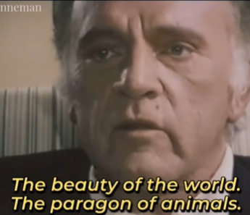
Does Consciousness Make Us Human?
Consciousness from APA
Interpretations [of it] divide along two (although not always mutually exclusive) major lines:
(a) those proposed by scholars on the basis of function or behavior (i.e., consciousness viewed “from the outside”—the observable organism); the reductionist or materialist perspective
(b) those proposed by scholars on the basis of experience or subjectivity (i.e., consciousness viewed “from the inside”—the mind). mental imagery; intuition; subjective experience as related to sensations, perceptions, emotions, moods, and dreams; self-awareness; awareness of awareness itself and of the unity between the self and others and the physical world
Which better explains this brief example of conscious behavior?
Notes:
The former generally represents the reductionist or materialist perspective (see materialism), whereas the latter generally represents the immaterialist perspective (see immaterialism). For example, functional or behavioral interpretations tend to define consciousness in terms of physical, neurobiological, and cognitive processes, such as the ability to discriminate stimuli, to monitor internal states, to control behavior, and to respond to the environment. According particularly to this view, the contents of consciousness are assessed through their ability to be reported accurately and verifiably (see reportability), although recent brain imaging research suggests that brain indices of conscious contents may become available.
; stream of consciousness; and other aspects of private experience. According to this view, the contents of consciousness can be assessed to some extent by their reportability but must also, given their phenomenological nature, rely on introspection. See also altered state of consciousness; evolution of consciousness.

Slide 9
HILARY
I'm not thrown by sharing an ancestor with a grunting chimpanzee — evolution by natural selection, bring it on — it's only that millions of years later the chimp is still grunting and you're using words like hypothesis, so I'm wondering if there's something they left out. It's nothing for you to be bothered by.
SPIKE
If not me, who? I'm Darwin. I'm Mendel. I'm Crick and Watson. I stand for all the science that's taught. We've scraped you clean of gibberish, we've taken you to bits and put you back together from the atoms upwards so you understand how you work and how everything around you works. We've accounted for every particle in the universe except for dark matter, and we're working on that. And here you are on your knees to what? To who? You might as well pray to Peter Rabbit.
HILARY
Explain consciousness
The Core of The Play?

Slide 10
The Brain Is A Machine
a computer is just an adding machine on speed
Amal, Leo and Hilary Keep The Argument Going In This Clip

Slide 11
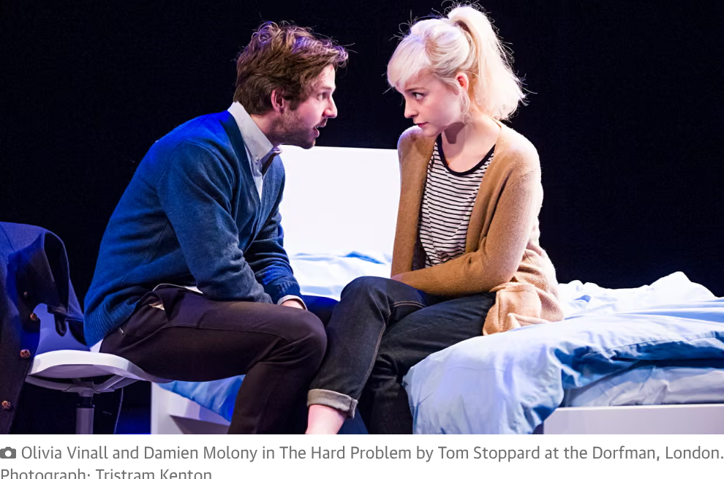
The Spine of THP's Narrative Is A Series of Arguments About Consciousness
So, let's take a look at The Hard Problem itself

Slide 12
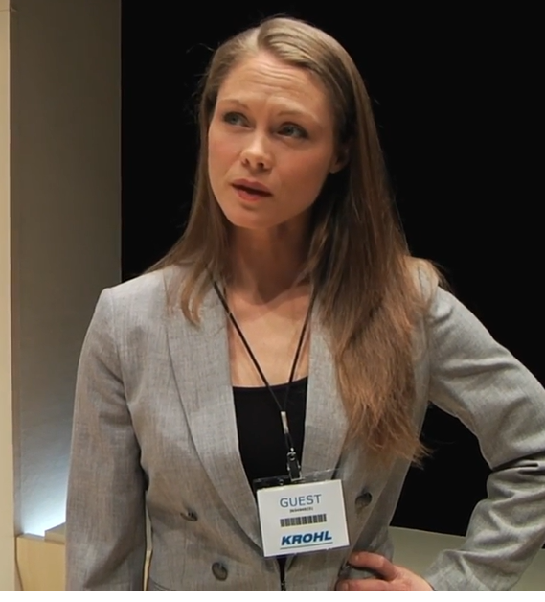
consciousness, free will Is the computer thinking?
A pivotal scene setting out the argument is here
Amal, Leo, & Hilary

Slide 13



The Subsuming Is In The Arguments

Slide 14
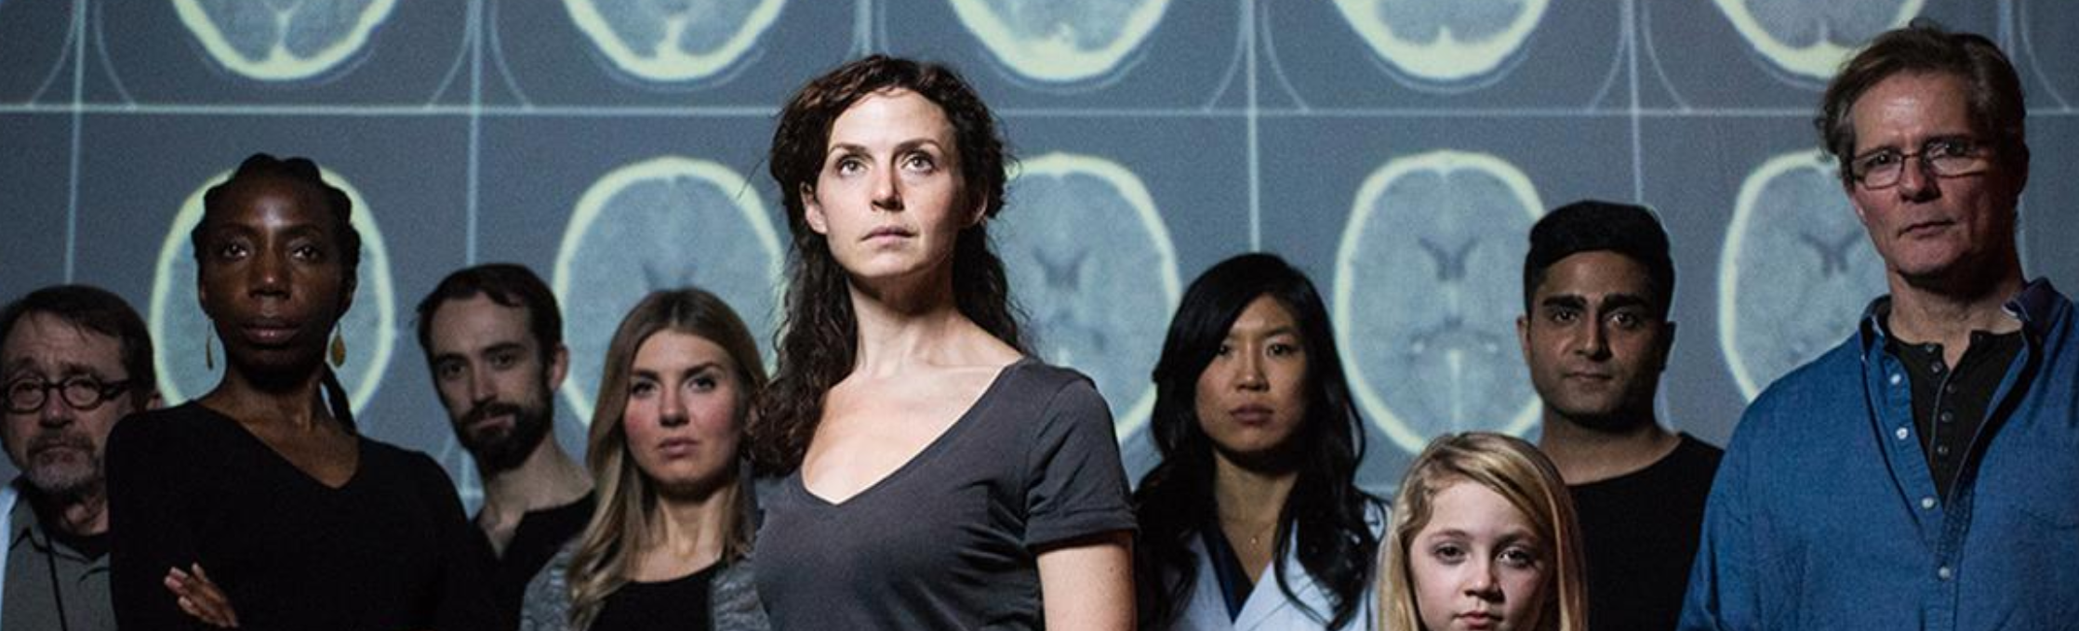
So, Let's Examine 'The Hard Problem' Itself
A Non-Expert Tour of Competing Theories of Consciousness, that internal awareness we all have of being awake, of thinking and feeling, of our beliefs and desires, and of perceiving the world around us.

Slide 15
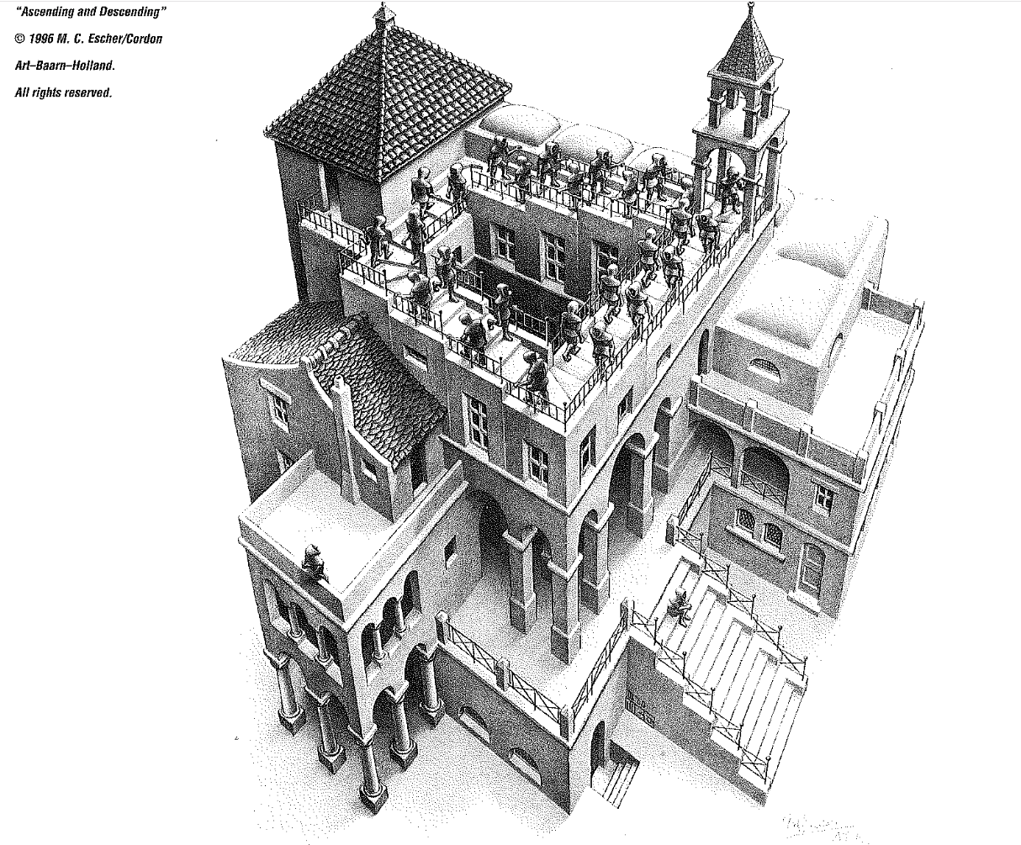
Consciousness Is A Puzzle, A Conundrum, An Enigma
Stoppard Doesn't Dare Try To Solve It, But His Play Strives To Make Us Ponder 'The Hard Problem'

Slide 16
If consciousness is something we know from inside ourselves, if our understanding of consciousness comes directly from experiencing it ourselves individually, how can its source only be physical matter? Robert Burnside offers context
"The typical human body is about 60% water, 15% proteins, 20% fats and 5% minerals. It’s also a combination of muscles, skeleton, blood, skin and various organs. Gosh what a mess! But we don’t run on electricity, we run on digested food, water, exercise, and fresh air."
[Unlike AI or computers] as a physical being we are a living organic being that grows naturally throughout life, in constant interaction with the world around, including social interactions with other human beings, including the love of our friends and family. We can think, feel and act. Within our organic living body, we have also a soul and some would say a spirit.
... [We are] physically based here on the earth, yet our thinking feeling and willing is in a living organic body that is unique to us as individuals. Each one of us has a different intelligence. … [And] Second, we are aware of many other non-human beings here on the earth.“

Slide 17
But An Impressive Lineup Confronts Robert, Hilary, and Stoppard
David Chalmers: Australian philosopher & cognitive scientist specializing in philosophy of mind and philosophy of language who coined the phrase “the hard problem of consciousness” but believed in ‘materiality’
Daniel Dennett: Philosopher denying that mental states exist entirely. For Dennett, elements of consciousness--like a sense of self or finding meaning in things--are actually just accidental consequences of some other effect. He uses the analogy of the redness of blood: blood’s redness serves no actual purpose, it is simply the consequence of iron in the blood, which does have a function. At its extreme, this view can lead to the hypothesis that consciousness is essentially an illusion that we live within.
Richard Dawkins: evolutionary biologist who argued in The Selfish Gene (1976) that human beings are “survival machines–robot vehicles blindly programmed to preserve the selfish molecules known as genes.” Because humans act to maximize the survival rate of their offspring, Dawkins claimed, their social behavior is inherently selfish. He argued that altruism, or the selfless action in support of others’ needs, is a myth.
Charles Darwin: In On the Origin of Species, he proposed the evolution of species occurred through natural selection—or, “the survival of the fittest”—in which the organisms that are best adapted to their environment are more likely to survive and reproduce, ensuring their traits are passed on to the next generation

Slide 18
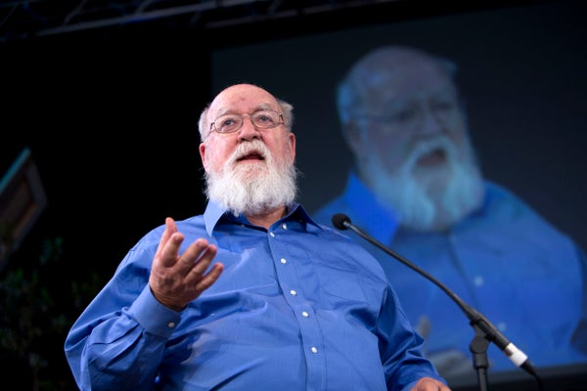
Dennett on Consciousness — Or Is That Spike Speaking?
“For many people, the idea that consciousness is a set of tricks is offensive or repugnant. They view it as a kind of assault on their dignity or their specialness. And I think that’s a prime mistake. If you think that way, you’re going to systematically ignore important paths of exploration and research. You’re going to hold out for mystery — for more specialness. Some people just can’t help themselves. They can’t or won’t take seriously the idea that consciousness is an amazing collection of almost mundane tricks in the brain.”
Daniel Dennett, 2012
“Dennett claimed that Darwinian theory can account for all aspects of our existence including consciousness … Dennett compares consciousness to the user interface of a computer. The contents of our awareness, he asserts, bear the same relation to our brains that the little folders and other icons on the screen of a computer bear to its underlying circuitry and software. Our perceptions, memories and emotions are grossly simplified, cartoonish representations of hidden, hideously complex computations.”
John Horgan — who disagreed with Dennett in 2024

Slide 19
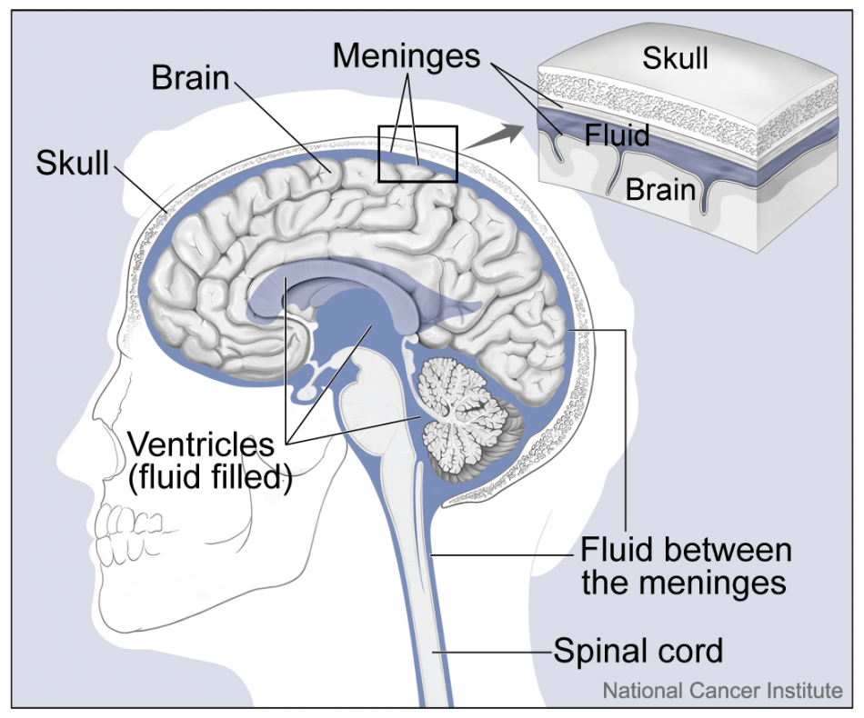
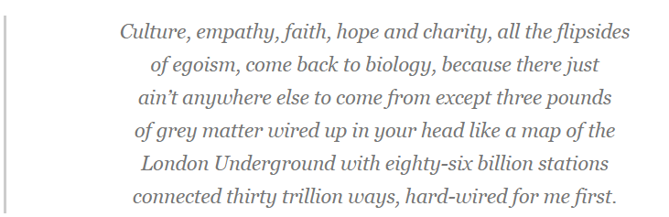
‘Three Pounds of Grey Matter’
Spike or Richard Dawkins or…

Slide 20
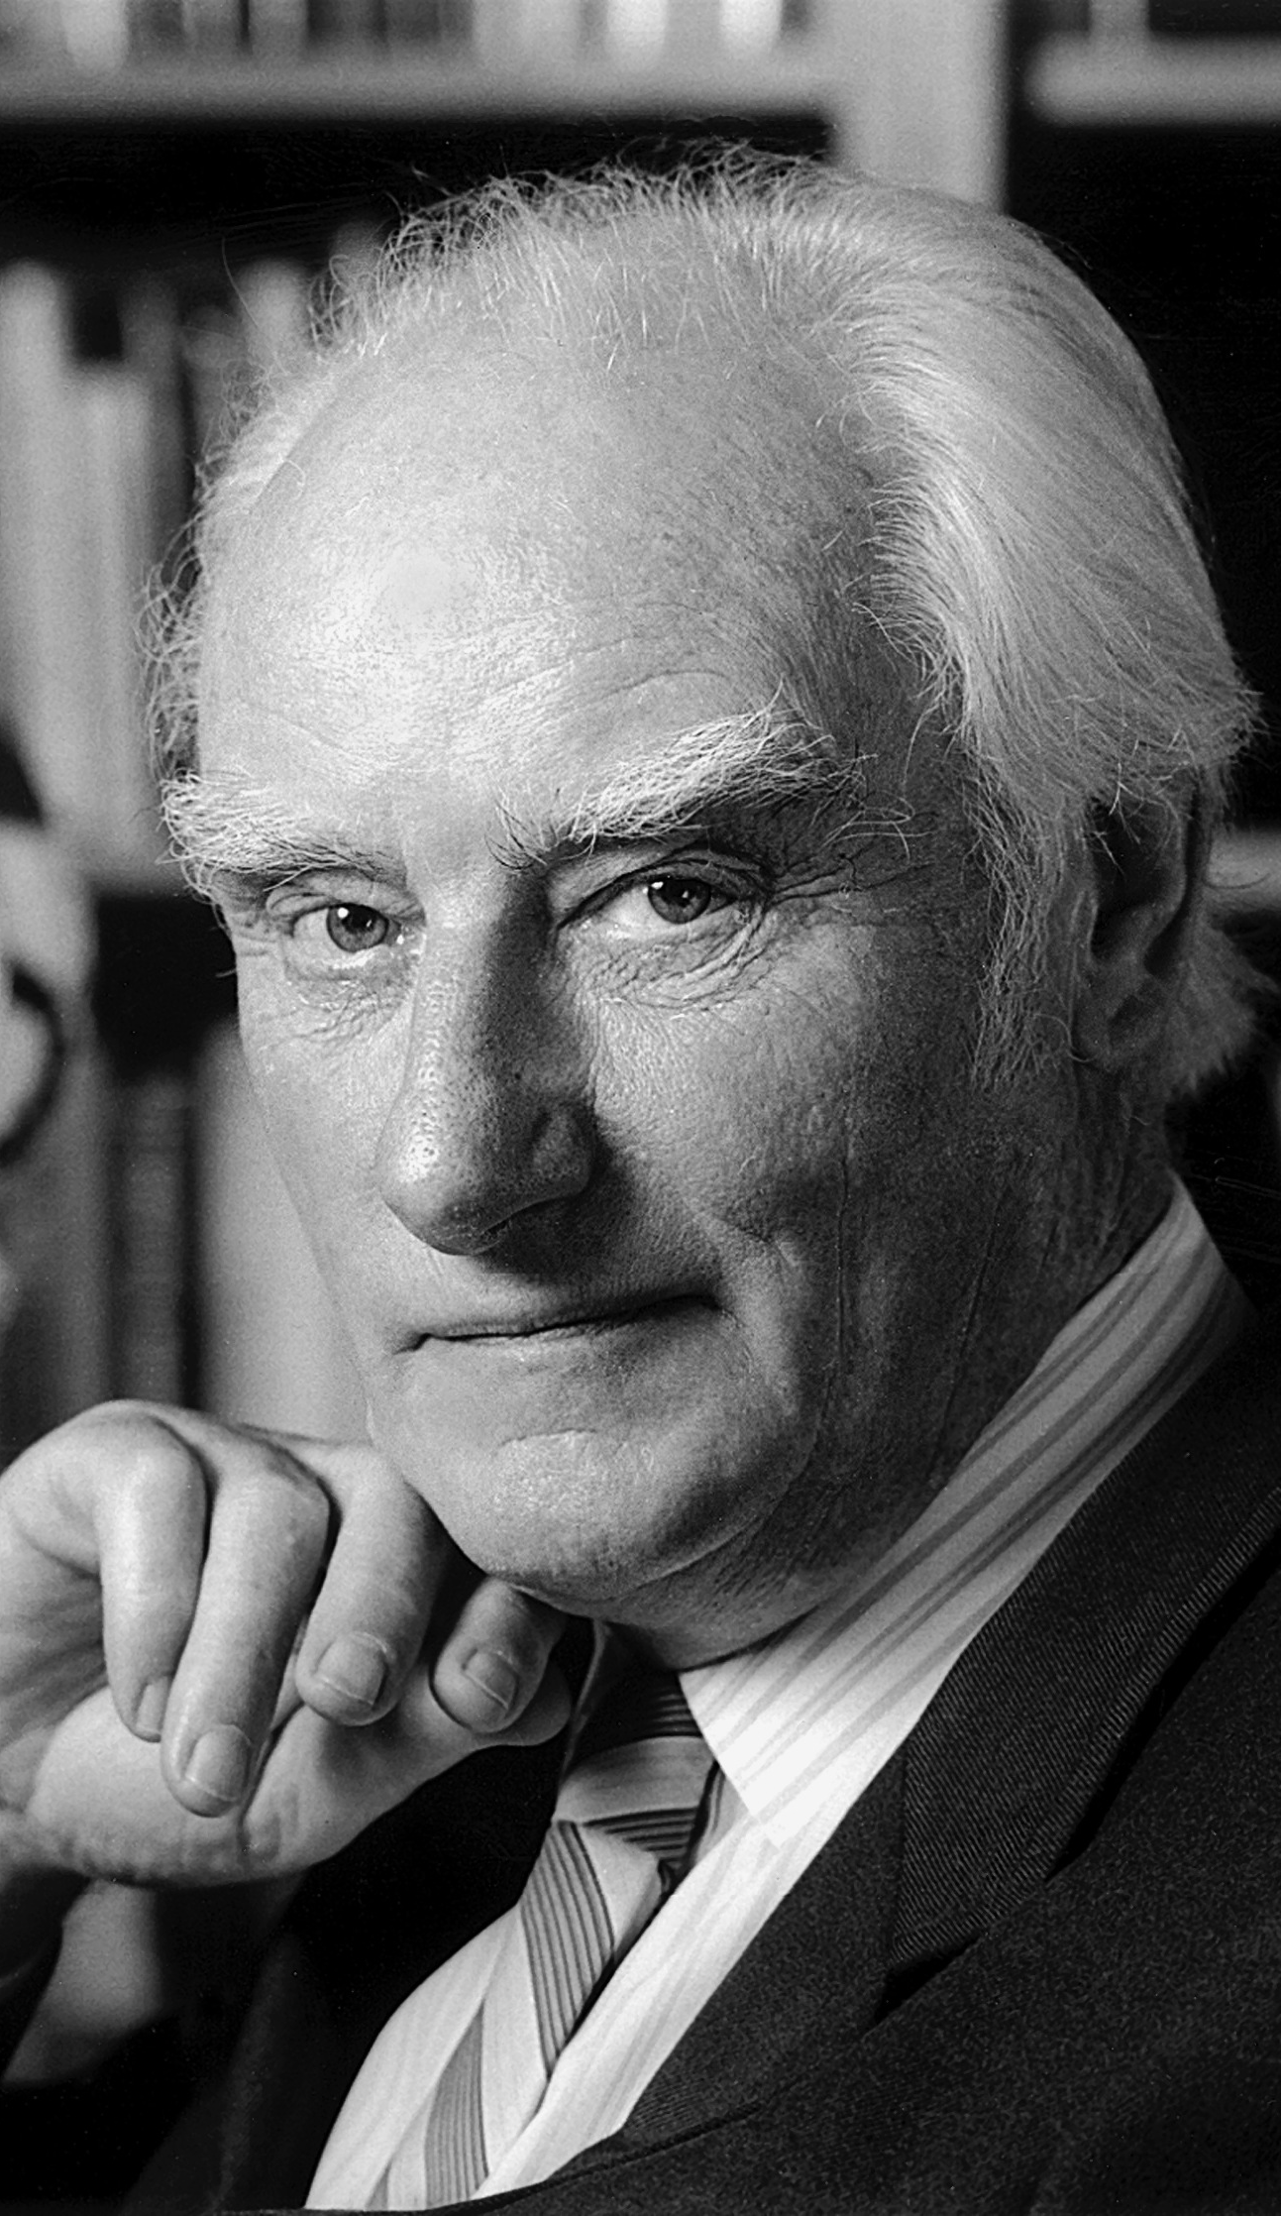
‘everything cannot be reduced to physical causes, but science pretends that it can’ Pretends? Or Claims?
“The second hard problem is that everything cannot be reduced to physical causes, but science pretends that it can. We don’t need a fictional character to express this opinion because we have Sir Francis Crick, the co-discoverer of DNA, who is quoted in the playbill of The Hard Problem as writing in his book The Astonishing Hypothesis:
‘You, your joys and your sorrows, your memories and your ambition, your sense of personal identity and free will, are in fact no more than the behaviour of a vast assembly of nerve cells and their associated molecules’”
From Colin McGinn

Slide 21
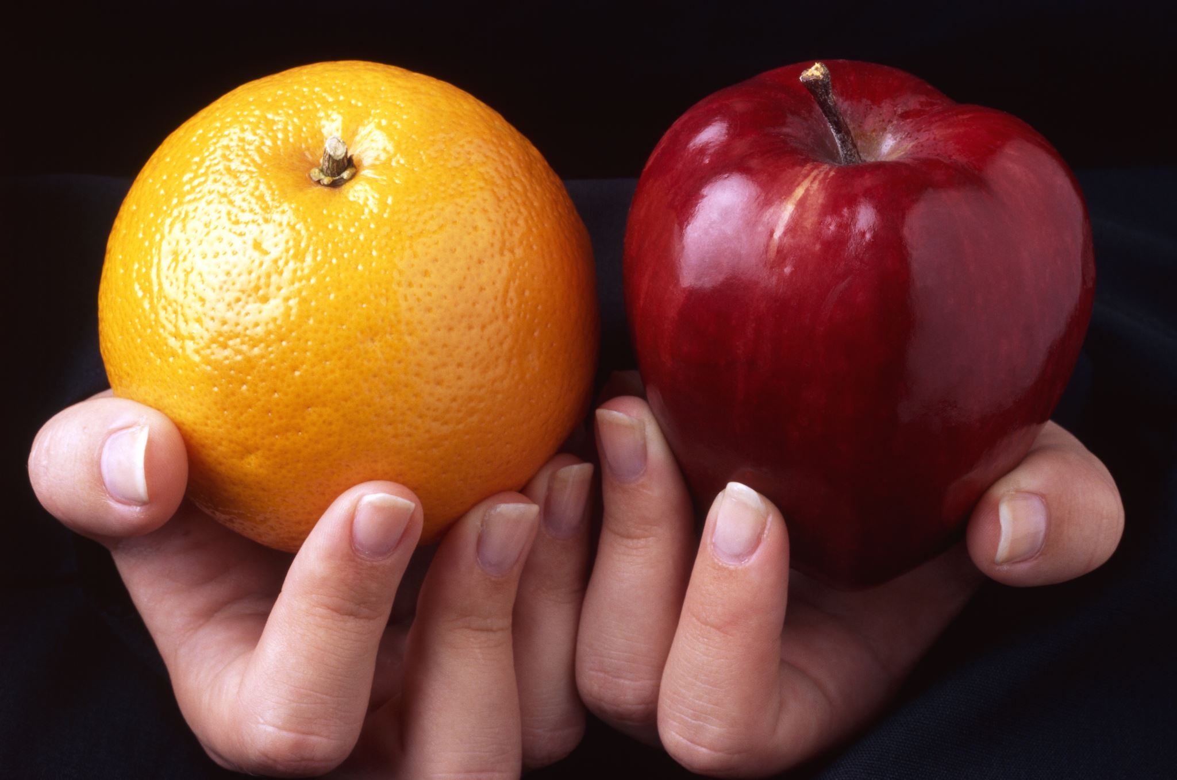
Materialism Versus Metaphysics: Apples & Oranges
Each side argues for its conception: the materialists deny any possibility of a non-materialist consciousness component; the metaphysics question how anything physical or chemical about the brain could explain the nature of consciousness

Slide 22
Between Those Points We Have The ‘Hard Problem’
“How does conscious experience arise out of non-sentient matter? This is the problem that the Australian philosopher David Chalmers famously termed the “ hard problem ” of consciousness. Unlike Daniel Dennett (see Daniel Dennett and the hard problem of consciousness), Chalmers does not dismiss consciousness as an illusion. Rather, he sees it as the largest outstanding obstacle in our quest for a scientific understanding of the universe. He coined the phrase “the hard problem” around 1994 and it caught on”
Colin Mathers
“Thomas Huxley says the problem of how the brain should produce consciousness is as mysterious as how the jinn appeared when Aladdin rubbed his lamp. That's a beautiful statement of the problem … (The hard problem) is “the largest outstanding obstacle in our quest for a scientific understanding of the universe”, why a subjective inner life exists
David Chalmers

Slide 23

Chalmers In The Middle
“It is undeniable that some organisms are subjects of experience. But the question of how it is that these systems are subjects of experience is perplexing. Why is it that when our cognitive systems engage in visual and auditory information-processing, we have visual or auditory experience: the quality of deep blue, the sensation of middle C? How can we explain why there is something it is like to entertain a mental image, or to experience an emotion? It is widely agreed that experience arises from a physical basis, but we have no good explanation of why and how it so arises. Why should physical processing give rise to a rich inner life at all? It seems objectively unreasonable that it should, and yet it does.”

Slide 24
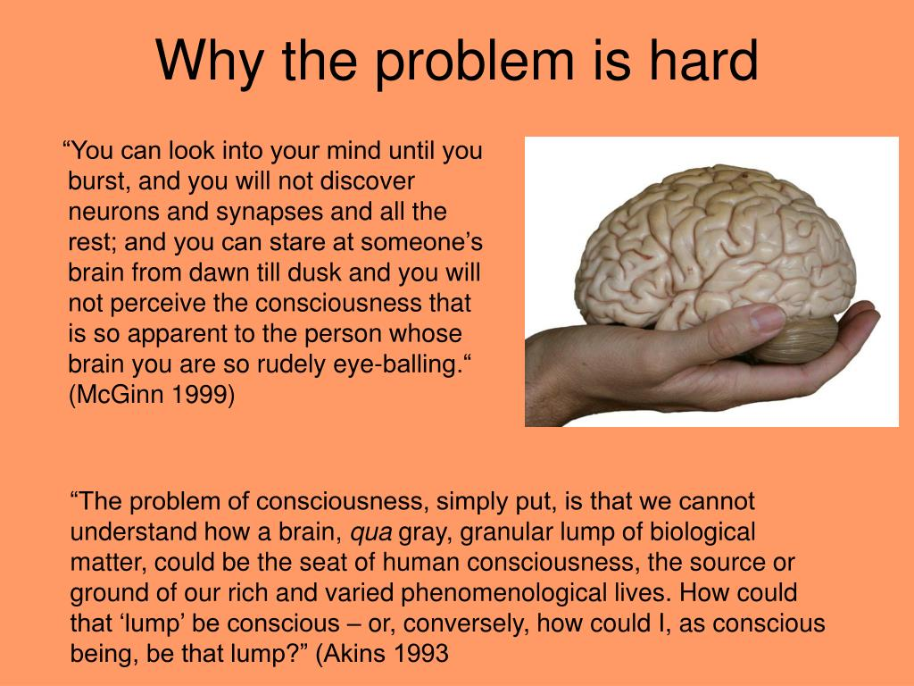
The Hard Problem: Two Views?
David Chalmers here in conversation with Tom Stoppard and Elisabeth Camp, Associate Professor of Philosophy at Rutgers University
https://youtu.be/4BPY2c_CiwA?si=sPJYKiRS7lqf7YfP&t=1831 To 33:11
And then from 36:30 to 38:44
https://youtu.be/4BPY2c_CiwA?si=pT_eWPYHSdrDwqB_&t=2187
Chalmers thinks there is quantification of value but that’s too far for us to go today. What do you think?

Slide 25
Hilary’s POV: Who’s the you outside your brain?
Hilary: What is to be done with the sublime if you’re proud to be a materialist? To save the appearance of value, no theory is too unlikely, no idea too far-out to float so long as it sounds like science … elementary particles with teeny-weeny consciousness; or a cosmos with attitude; or the life of the mind as the software of a biological computer. These are desperate measures, Spike!
Spike: But it's pathetic to rely on the supreme being to underwrite what you call your values. Why are you afraid of making your own?
Hilary: You don't claim to make your own. What's the difference between a supreme being and being programmed by your biology?
Spike: Freedom. I can override the programming.
Hilary: Who can? Who's the you outside your brain? Where?

Slide 26
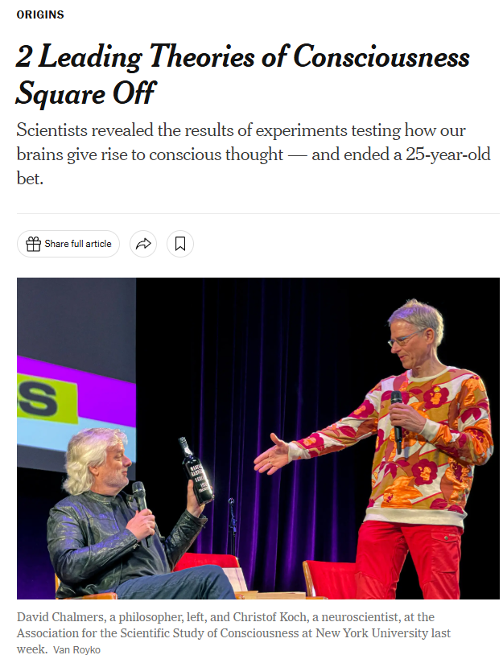
Who Won?
The friendly 25-year bet about consciousness between David Chalmers and a neuroscientist, Christof Koch: Can scientists find a clear neural correlate of consciousness?
“Dr. Koch wagered his friend that scientists would find a neural correlate of consciousness within 25 years. Dr. Chalmers took the bet. The prize would be a few bottles of fine wine.”
“But the 25-year bet, at least, has been resolved: No one has found a clear neural correlate of consciousness. Dr. Koch ended the evening by carrying to the stage a wooden box full of wine. He pulled out a 1978 bottle of Madeira and gave it to Dr. Chalmers.”
The full article from July 2023 is at this link

Slide 27

Leo Summarizes The Difference
“Leo, Hilary’s boss at the institute, summarises the difference between the two types of consciousness while at the same time broadening out the concept of hard problems to include what he calls ‘self-consciousness’”
Nigel Purse
“A mouse is a bundle of behavioural responses to physical stimuli. Poking it with a stick is the same thing bigger. Light photons hit the retina, small molecules get the whiskers twitching, and improved technology will show the mechanism all the way to cheese response....But cognition – reasoning, imagining, believing...that’s hard. How does the brain do self-consciousness? – reference? – metaphor? ‘I wandered lonely as a cloud’. As a what? ‘Thy two breasts are like two young roes that are twins, which feed among the lilies’. Like two what which what? That’s hard. Where is it happening? How?”

Slide 28
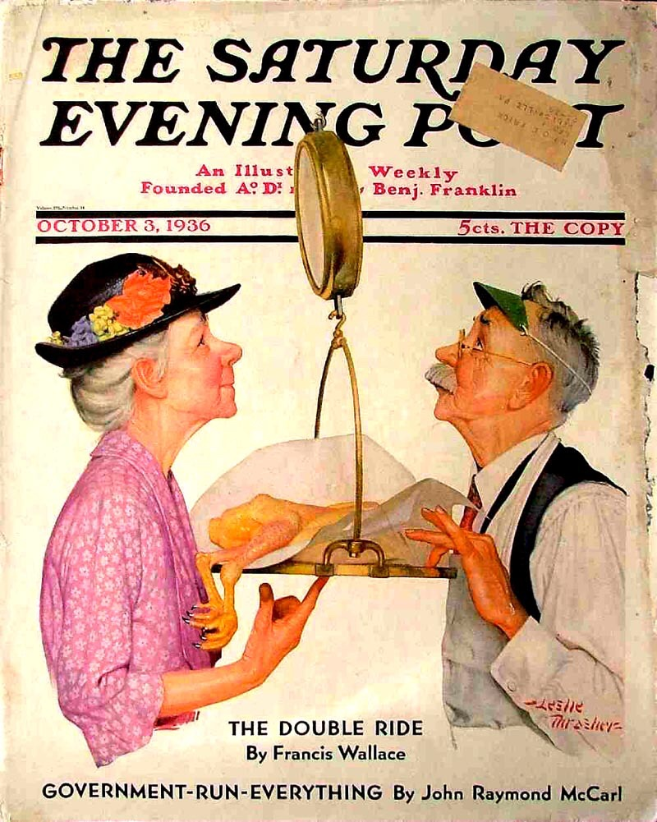
Is Sir Tom Putting His Thumb On The Scale In These Arguments?

Slide 29
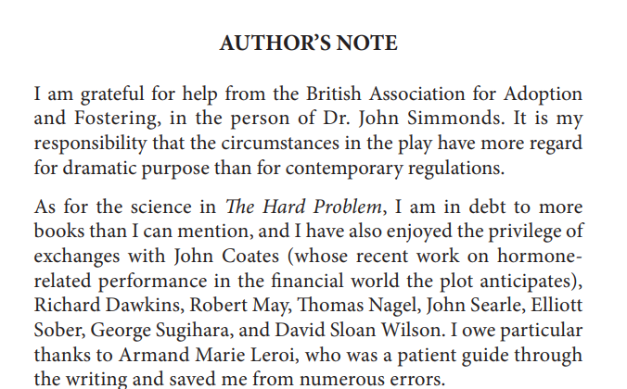
Sources Say Something, Don't They?

Slide 30
TS and Hilary’s Take Looks Like Colin McGinn’s
“But in the case of consciousness the Darwinian explanation does not tell us what we need to know, for the simple reason that it is unclear how matter can be so organized as to create a conscious being. The problem is in the raw materials. It looks as if with consciousness a new kind of reality has been injected into the universe, instead of just a recombination of the old realities. Even if minds showed no hint of design, the same old problem would exist: How can mere matter originate consciousness? How did evolution convert the water of biological tissue into the wine of consciousness? Consciousness seems like a radical novelty in the universe, not prefigured by the after-effects of the Big Bang, so how did it contrive to spring into being from what preceded it?”
Colin McGinn
Stoppard wants us to understand that science goes on a fool’s errand when it looks for a physical basis for consciousness. He would rather examine consciousness using philosophy. He believes we will never understand the mind through studying the brain. As Hilary jokes, “Consciousness? It’s a no-brainer.”

Slide 31
Roots of TS Resistance to Reductionism and Rationalism
“There is more in me than meets the microscope”
“The idea of God is slightly more plausible than the alternative proposition that, given enough time, some green slime could write Shakespeare's Sonnets.”
Jumpers, Written 1971
“ The Hard Problem cannot help but put the viewer in mind of Dostoyevsky’s remark that in a world without God, ‘everything would be permitted, even cannibalism.’ For Mr. Stoppard, the really hard problem is that living as he does in the modern world, he finds it equally impossible to believe or disbelieve in God.”
Terry Teachout reviewing THP in 2018
“I absolutely firmly believe that what are quite coincidentally known as Christian values are good in themselves and don't need rationalisation. I don't believe that telling the truth and not stealing are mechanistic human conventions which we have evolved by living in groups. They transcend all such notions. Some behavior is good in itself, and some behavior is bad in itself.”
Interview with Mel Gussow April 1972!

Slide 32
THP theme in Rock and Roll
Character matters. Max’s dying wife, Eleanor, becomes one of the most moving and powerful figures in all of Stoppard because of her own acute vision. A classicist who understands that human nature has never really changed, she is outraged by her husband’s dialectical materialism, which he stubbornly sees as a kind of integrity:
Eleanor: They’ve cut, cauterized and zapped away my breasts, my ovaries, my womb, half my bowel, and a nutmeg out of my brain, and I’m undiminished, I’m exactly who I’ve always been. I am not my body. My body is nothing without me, that’s the truth of it. (She tears open her dress) Look at it, what’s left of it. It does classics. It does half-arsed feminism, it does love, desire, jealousy and fear—Christ, does it do fear!—so who’s the me who’s still in one piece? Max I know that—I know your mind is everything. Eleanor (furious) Don’t you dare, Max—don’t you dare reclaim that word now. I don’t want your “mind” which you can make out of beer cans. Don’t bring it to my funeral. I want your grieving soul or nothing. I do not want your amazing biological machine—I want what you love me with.

Slide 33
But is there also in THP a further reflection on Romanticism? The elements of existence beyond scientific analysis or explanation?
"In Romanticism, feelings, or what Martin Heidegger would later call 'moods' (Stimmungen, a term that in German is etymologically connected to the word for 'voice') are a category of human experience quite distinct from thoughts.... Like the Romantics, Heidegger is committed to the idea that there are experiences we can have as human beings that are intrinsically and necessarily out of reach of scientific investigation.”
Justin Smith-Rhiu
Yes, Heidegger became a Nazi, but he provided this insight in 1927

Slide 34
Is God?
"It's quite difficult to avoid some overall moral intelligence. I'm perfectly happy to call it God and yet the word god brings so much with it that I also resist the word while accepting it.”
What might moral intelligence mean? Some intrinsic sense of what is “or relating to human character or behaviour considered as good or bad; of or relating to the distinction between right and wrong, or good and evil, in relation to the actions, desires, or character of responsible human beings; ethical.”

Slide 35

Supreme Being or Biology?
TS: “There’s an exchange in THP where a young woman, (Hilary) believes X and a man (Spike) who believes Y, and the man asks her why she’s afraid to make her own values instead of wanting them underwritten by a “supreme being”, and she says to him something like, “What is the difference between a supreme being and being programmed by your biology?” He replies: “Freedom. I can override the programming.” And she says: “Who can? Who is the you outside your brain? Where?” And I still do not understand how you escape that loop.”
GOD as ‘overall moral intelligence’
"It's quite difficult to avoid some overall moral intelligence. I'm perfectly happy to call it God and yet the word god brings so much with it that I also resist the word while accepting it.”
What might moral intelligence mean? Some intrinsic sense of what is “or relating to human character or behaviour considered as good or bad; of or relating to the distinction between right and wrong, or good and evil, in relation to the actions, desires, or character of responsible human beings; ethical.”

Slide 36
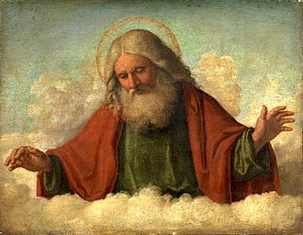
‘Chemistry came alive and kicked into an algorithm’ vs. ‘Now do God’
HILARY So you liked her equations?
SPIKE I liked them, but they're not tied into hard data.
HILARY Yeah, they show there isn't enough geological time for the living world to have been selected out by chance mutations.
SPIKE Really? Look around. You're just hung up on your personal incredulity.
HILARY Well where's yours? Someone tells you can run the film backward billions of years to an enormous bang and nothing but particles joining up into big clumps like this one, except not like this one—because on this one chemistry came alive and kicked into an algorithm that kept unspooling till there was you collecting spit from a poker game, and you don't bat an eyelid.
SPIKE Yep. Love it. Now do God and see which one of us looks credulous.

Slide 37

The Other Side: Morality Is Self-organizing
‘Stoppard’s characters are troubled by how morality can evolve, when there are fascinating examples of altruism in chimps and a sense of justice in monkeys.”
Rowan Hooper
. But what I meant when I said 'morality is self-organising' – because it's an interesting question for history: where does morality come from? And you might say morality came from God – okay, that's one kind of answer. But you could say morality came from evolution; it's natural selection, which is all we're talking about here, trying to win at the game of life. If natural selection leads to morality, that's pretty interesting. And that came from maths!"
Steven Strogatz, the Jacob Gould Schurman Professor of Applied Mathematics at Cornell University
Notes:
I mean, the one thing that's really good about 'tit for tat' is that … the player who always defects – he can't make much progress against 'tit for tat'. But it can against the very soft, always cooperating strategies. You end up getting into these extremely long cycles going from all defection to 'tit for tat' to always cooperate and back to all defection. Which sort of sounds a lot like some stories you might have heard in history. Countries or civilisations getting softer and softer and then they get taken over by the barbarians.
Rowan Hooper article is here: https://www.newscientist.com/article/dn26878-the-hard-problem-is-stoppards-problem-with-science/

Slide 38


So what is Stoppard up to? Claiming An Overall Moral Intelligence?
Spike asks Hilary what God is for: “you need something for it to be true, some kind of overall moral intelligence, otherwise we’re just marking our own homework. That’s what I pray to…because somewhere between ape-men and the beginning of religion, we became aware of an enormous fact we didn’t understand.”
"Through the character of Hilary, he is suggesting consciousness cannot be explained in purely mechanistic terms and that there are intrinsic values that depend on an overall moral intelligence. In previous plays..., Stoppard has implied that those values are instinctively to be found in children. It is significant that Hilary is partly driven by a thwarted love for an absent child."
"Stoppard’s play may not solve the hard problem of human consciousness. But it offers endless stimulation and represents, like so much of his work, a search for absolute values and a belief in the possibility of selfless virtue. For all his reputation as a cerebral writer, Stoppard has a strong faith in the power of the irrational.“ Michael Billington, The Guardian, 01/28/2015

Slide 39
‘God Is Love And He Who Abides in Love Abides in God’: Stoppard, Altruism, & The Prisoner’s Dilemma

Slide 40
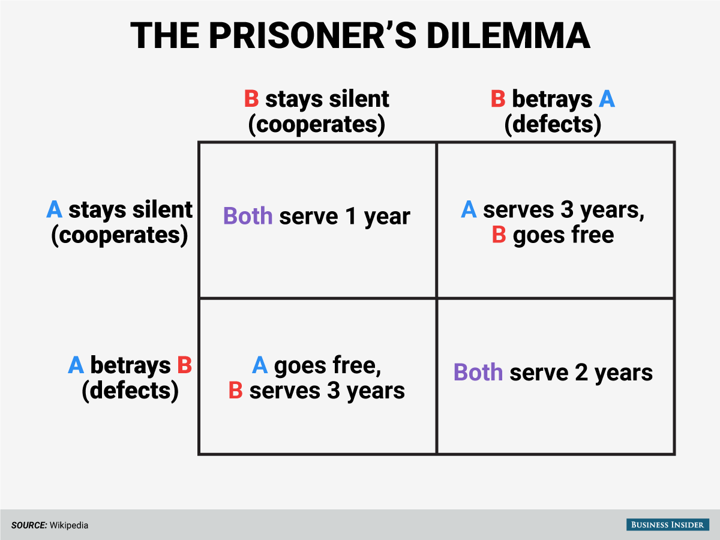
The play opens with Hilary and Spike discussing the prisoner’s dilemma A prisoner’s behavior, Spike insists, can be predicted by behavioral models. Hilary disagrees: what if one of the prisoners is in love with the other? Doesn’t that throw a wrench into the model, as behavioral models that predict selfish behavior don’t accommodate this possibility?

Slide 41
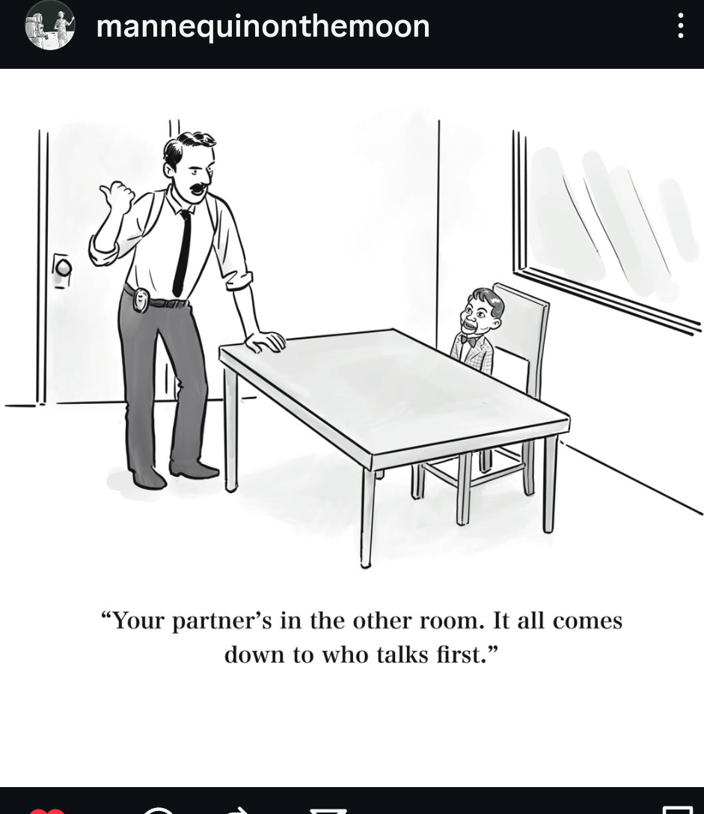
What's real? Begin With That Beginning: The Prisoners Dilemma Why do you think Stoppard uses that game as the start of our engagement?
Notes:
Various mechanisms for the evolution of cooperation have been proposed including kin selection (Hamilton, 1964), group selection (Wilson, 1975; Wynne-Edwards, 1962), indirect reciprocity (Nowak and Sigmund, 1998, 2005) and spatial (or network) reciprocity (Nowak and May, 1992; Ohtsuki et al., 2006; Skyrms, 2004). Here we analyze direct reciprocity which was introduced by Trivers (1971).
“…The simplest strategy is tit-for-tat (TFT), submitted by Anatol Rapoport (see also Rapoport and Chammah, 1965). TFT cooperates in the first round and then does whatever the opponent has done in the previous round. It will play C for C and D for D. Hence, TFT embodies the simple principle ‘an eye for an eye and a tooth for a tooth’. It was remarkable that TFT won both tournaments, because participants of the second tournament knew the outcome of the first and tried to design (more sophisticated) strategies that were superior to TFT.”
…TFT’s unrelenting punishment never forgives even a single deviation, but forgiveness is needed to restore cooperation after occasional errors (Fudenberg and Maskin, 1990; Molander, 1985; Nowak and Sigmund, 1992)… “…Win-stay, lose-shift (WSLS) is a very simple strategy which has neither of these two weaknesses (Nowak and Sigmund, 1993). WSLS works as follows. If WSLS receives payoff T or R it will repeat the same move next round, this is ‘win-stay’. If WSLS receives only payoff P or S, it will switch to the opposite move, this is ‘lose-shift’. Thus, the choice of the next action is based on some aspiration level which lies between P and R.”

Slide 42
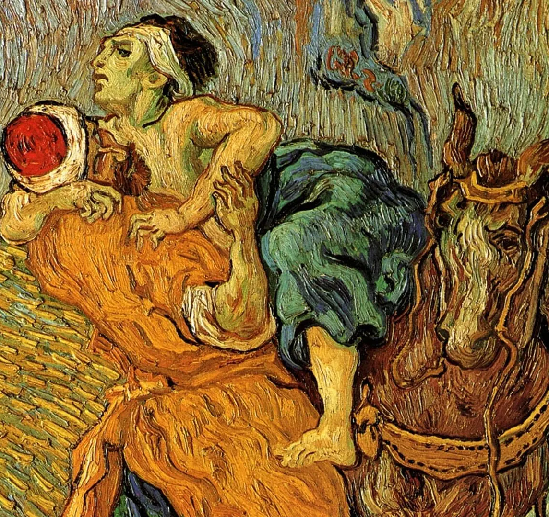
Hilary Breaks the PD Rules
The Good Samaritan after Eugène Delacroix by Vincent van Gogh, 1890.
HILARY: Rational? You have to be a person to be rational. You've left out everything about Bob and me except we're each out for ourselves and we've got 2 buttons to push. Actually, Bob loves me . SPIKE: Hold on. HILARY: I did it. Bob had nothing to do with it, he wasn't even there. SPIKE: That's not one of the options.
HILARY: I smashed the window, grabbed the jewelry and hid it under the floorboards. SPIKE: It's not an option in the game.
HILARY: I'm confessing anyway. I'm going to give Bob a chance to go straight.
SPIKE: Why?
HILARY: Because I'm good.

Slide 43

“She Needs To Believe That You Can Be Good”
Let’s listen to Stoppard offer his precis of the play here; it’s a little over two minutes:
https://youtu.be/il5CT1n4ql0?si=7Mu98IL6DJ8yXEeA

Slide 44

“Goodness is something that has always interested you”
“HOW DO WE DERIVE VALUE FROM WHAT WE KNOW OF THE PHYSICAL WORLD?”
TS from 5:03 to 9:23
“I will read a letter received when TS was starting to write this play, which I will then use to ask him about the play
Tom wrote, ‘I want to write a character who is good not goody goody and believes that goodness has an objective reality which is not captured by explained by defined by evolutionary science by evo-psychology Evo biology by Neo Darwinism the character is a young woman who's in her early 20s at the beginning of the play the time span is about 10 years Circ 1999 to 2008 the setting is based on some place like the Allen Institute in Seattle but we're in England Paul Allen ex-Microsoft has financed a brain science lab to investigate how brains work etc the play's dates are to accommodate my my hazy notion that my Allen is a hedge fund guru and that the credit crunch is where we're heading so a play about evolutionary biology and the banking crisis. Happy Christmas! ‘
Notes:
So, Tom I think goodness and the objective reality or not of goodness is something that you've been concerned by throughout your playwriting career what was it particularly that fired this play?”

Slide 45
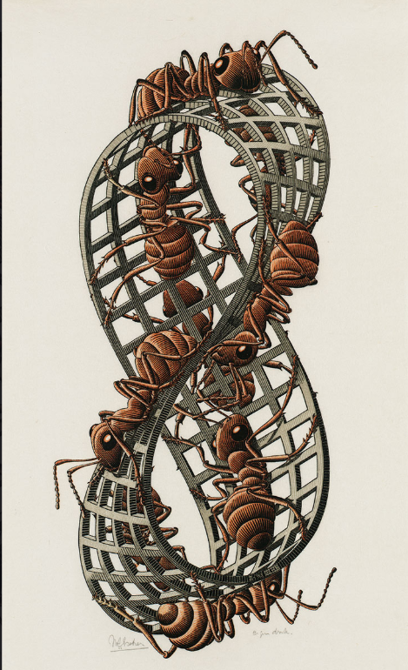
Stoppard on Morality: “the idea of goodness isn’t implicit in what we call good behaviour. That only leaves you with a Mobius strip. It’s only implicit in relation to something you can compare it with; e.g., its opposite
“A Möbius strip is a spatial form that has only one surface and one edge. There is no outer edge or inner edge … the Möbius strip is actually possible. It only appears impossible. For Escher, however, it was not enough simply to represent the figure as attractively as possible. He challenged both himself and the viewer by making the strip partially see-through, and depicting nine ants walking along it as if on an endless treadmill.

Slide 46
Stoppard on Morality: the concept of value and from where that arises is at the heart of THP — Amal, Bo, Spike, and Hilary all provide examples. What do you think they are?
“Just seems to me that the idea of real morality is unintelligible without Consciousness ... the core part of what engaged me was the question of value; that how do we derive value from what we know of the physical world? Because, and when I say value, I mean value in every sense, to put it as simply as possible we can say that Virginia Woolf was a taller writer than Iris Murdoch, no problem there. If you start saying she was better or not as good as Iris Murdoch there you enter an area of what value actually is, whether it's subjective or whether there are external measures, but more important than literary value there naturally there's a whole area of ethics and moral philosophy”

Slide 47

Nature-Nurture Convergence In Egoistic And Altruistic Parent-Offspring Behavior
What does it mean?
Title of Hilary's Paper

Slide 48
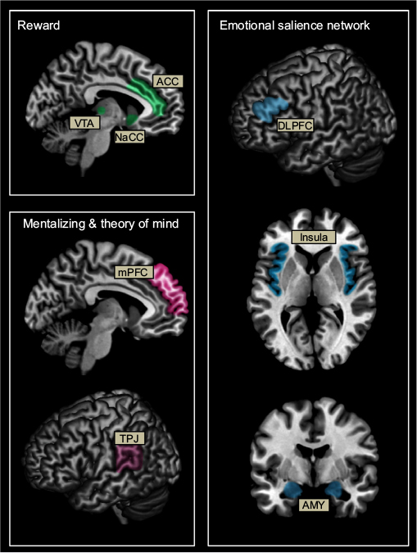
Altruism
“The first hard problem is altruism and goodness in all of its forms. For Tom and his protagonist Hilary, science is a parched desert when it comes to explaining the nature of goodness. As Spike, the supremely confident scientist in the play puts it, ‘Above all, don’t use the word good as though it meant something in evolutionary science!’” … “The third hard problem is that even if science can explain the kind of instinctive altruism found in bees and brainworms it can’t or at least hasn’t explained the kind of consciously motivated altruism found in humans.” — David Sloan Wilson
“Science looks fair to solve the technical mysteries one by one. And when they are solved, the question is: what is the meaning of that, does it have any meaning? I think a lot of our altruism, which we all exhibit, happens on a one-to-one level, with family, for example. You’re impassioned about making the world a better place in your town and ultimately in the planet and you’re going to do it by manipulating the environment so that the environment produces objectively better social behaviour. That’s admirable, but in the truest kind of way it misses out altruism completely. Altruism is what you do for somebody you love, and you don’t love good order and sociality in the same sense that you love your family.”— Tom Stoppard
“But typical Stoppard, he introduces an element (in the Prisoner’s Dilemma game) that game theory cannot admit the altruism for which Hilary's experiment motivational experiment is testing” — Nigel Purse
Schematic representation of brain networks associated with reward (green), mentalizing and theory of mind (pink), and emotional salience (blue) thought to be involved in altruistic behavior
Notes:
[NB There are arguments that chimpanzees, etc. exhibit altruism]

Slide 49
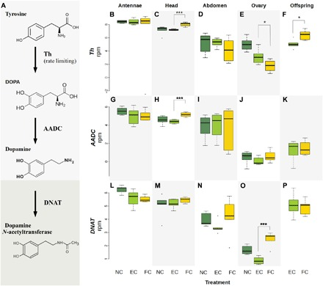
‘The genetic mechanism of selfishness and altruism in parent-offspring coadaptation’
“Two genes coordinate selfishness and altruism, and more than 1600 genes are associated with parenting in mothers or offspring.”
“In rat mothers, dopamine levels were associated with pup licking and grooming behavior; in vervet monkeys and humans, variable number tandem repeats in exon III of the dopamine receptor DRD4 gene were associated with parent-offspring interactions”
Min Wu , Jean-Claude Walser , Lei Sun , Mathias Kölliker

Slide 50

Justified by Biology
“Stoppard’s characters argue not just about machine intelligence, but about the possibility of altruism as humans experience it, rather than as evolutionary biologists can analyse it. Consciousness can’t be reduced to brain mechanisms, says the heroine, and love can’t be understood entirely as self-delusion, or as a tarpaulin thrown over the horrible mechanisms of genetic selfishness to conceal our real motives from ourselves.” Andrew Brown in The Guardian
Bo: I think it’s good to be good, I don’t see that it matters what makes you good.
Hilary: It might matter if people who are out for themselves think they’re justified by biology

Slide 51

A Rebuttal by Hilary (Stoppard?)
“Who’s the you outside your brain? Where? The mind is extra….We’re dealing in mind-stuff that doesn’t show up in a [brain] scan—accountability, duty, free will, language, all the stuff that makes behavior unpredictable”
Altruism “means being good for its own sake”
Hilary: I agree with you, Spike. Virtue is not a science. You can’t get an ought out of an is. Morality is not science. So there must be something else, which isn’t science. Which science isn’t. What is it?
Spike: You don’t like the idea that you’re nothing else but an animal. It’s conceit. You’re an animal. Get over it.

Slide 52

How Does This Connect to $$$?
“Scene 8 concludes with Leo’s explanation of “a trader’s appetite for risk” as if he is defending the risk taking upon which his boss’s Empire was founded and which sustains his livelihood.
“A threnody reverberating through Stoppard’s play is indeed the question of the ethical nature of capitalist adventurism and risk taking in a roller-coaster market.
“Such a concern spills into scene nine which takes place at Hilary’s flat where she is holding a dinner party. … Amal, Julia, Bo and Spike respond to Ursula’s question concerning “what a hedge fund does.” ́ For Spike it’s a gamble in which the only winner can be Jerry if the money is invested in Kroll Capital Management. For Bo ‘getting round the rules is the reason for hedge funds.‘” Amal’s, the trader, emphasizes a contempt for altruism [from William Baker]
Is the enterprise that supports all of them portrayed as the obverse of altruism? Selfish? Amoral?
Hilary will say that she never thought of Catherine as being a rich kid. Is that a conflict? Or in the end does her self-interest see a different ‘good’?
This Photo by Unknown Author is licensed under CC BY

Slide 53
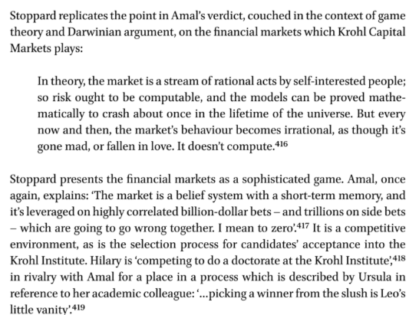
These events — market behaviour, Leo’s vanity — reinforce for Stoppard a conviction in what one scientist called ‘an indeterminacy at the root of human affairs’
Nigel Purse, Tom Stoppard’s Plays: Patterns of Plenitude and Parsimony

Slide 54
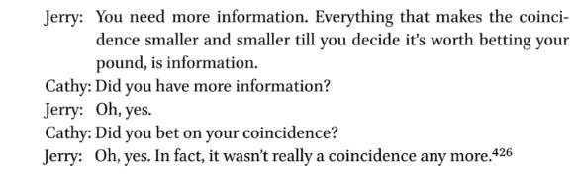

Jerry, Information, Consciousness, Market Success

Slide 55

The Holy (Unholy?) War: Scenes Two & Seven
Do Hilary & Spike Change?

Slide 56
Rationalism confronted again
George and Dotty in Jumpers, R&G in R&G are Stoppard's representatives of human beings trying to remain human in this world of rationalism and self-interest. So are Hilary and her boss in THP
Using mathematics this is another in a series of cleverly staged debates about providence versus free will, the existence of moral absolutes, and the origins of human consciousness. Contrary to expectations, the mathematics in these plays most often serves as a catalyst for the persistence of uncertainty in a rising tide of rationalism.
the tension between rational order and randomness see notes Stephen Abbott
Notes:
The Mathematical Heart of Tom Stoppard
Stephen Abbott
Modern Drama
University of Toronto Press
Volume 67, Number 1, March 2024

Slide 57
Knowing again a concern
Hermione Lee: Stoppard “believed in prayer, however, foolish one might feel in doing so. His prayer had nothing to do with organized religion: it came out of a sense of something beyond our knowledge, beyond the material world.”
Alistair Macaulay, writing about Stoppard’s The Invention of Love, observes that ”most or all Stoppard plays are about epistemology — about the various ways in which our brains apprehend and address the world, the range of possibilities whereby experience and thought become knowledge. And the nature of knowledge — what has been lost, forgotten, mistaken? — is an abiding theme.´

Slide 58

Technique: Blending, Rewriting, Analogies, Focusing, Callbacks, Dramatic Irony, Characterization, Dialogue

Slide 59
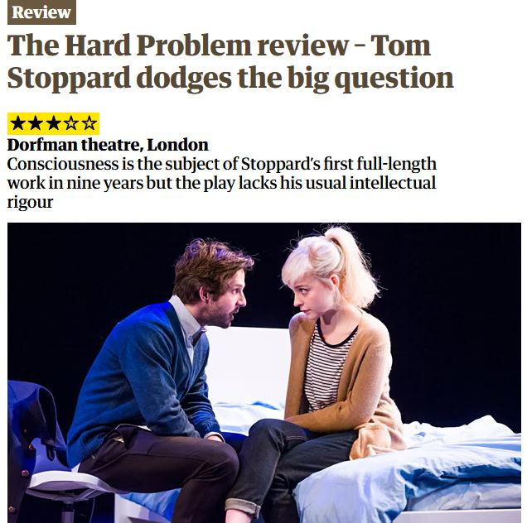
Did The ‘Subsuming’ Work This Time?
“I live a lot longer with the idea in a play than with the story which I’m using to carry them. So I tend to be still trying to get the story right when we are rehearsing or even, God help us, reviving the play.”
“You have to integrate the internal profound subject with the narrative subject.”
Tom Stoppard

Slide 60
Technique: Two plays colliding as Trevor Nunn noted
TS: “I had a desire to write a short brisk play with no intermission I know that sounds like a banal way or point of departure but it's quite an important one to me because it establishes the the nature of the play, the tone of the writing. It may strike some of you as surprising if you've seen The Hard Problem, but I think of it as a piece of minimalism because one could as it were fatten it up but the play tends to go from point to point and from response to counter response. That was what I wanted to do.”
TS: “I would like to be in this chair saying that I had this early perception that the world of Finance offered a way of dealing with in some opposite way dealing with questions of how the brain actually worked. I would like to say that it occurred to me that the notion of a computational brain might be thought to be at odds with the way the market goes wrong having as it were having established computationally that nothing can possibly go wrong and that what I've just said was true of me and the process at a slightly later stage. What actually happened,... is that I was thinking I really would like to write a play about Consciousness, and I'd really like to write a play about the financial crisis and I collected material for both plays and then I just thought I really don't want to waste this stuff by writing the other one so I thought actually there's a way where they impinge upon each other. And the way in which they impinge is (it's obviously quite a simple notion but not less true for its Simplicity) is that since we became familiar with the computer the notion that that explains our brains became very very attractive to very many people who are reluctant to let go of it. I mentioned in a program note that John Searles, who was writing about these things for the last 20 or 30 years, he found that the adherence of as it were religious doctrine.”

Slide 61
Technique: Rewriting
"What continues to amaze me about Stoppard, with whom I have worked nearly a dozen times now, is his willingness to rewrite, reimagine, rethink, while always staying absolutely true to his own voice and his first instincts. Over a long weekend in Dorset, we went through every line of The Hard Problem, trying to tease out the balance of science and faith, intellect and instinct. I was wrestling with the character of Spike and what he actually felt for the protagonist, Hilary; Tom hilariously tried to explain to me the difference between a bed partner and a boyfriend, and argued for the obsessive love of science which seems to cloud the rest of Spike’s mind. But he was willing to dive into the Venice hotel room scene in the play and bracket a whole chunk of scientific argument, considering whether that excision would allow the warmth between the two of them to better emerge. We talked about how to make it clearer that the global economy is in free fall by the end of the play, we spoke about hedge funds and brain science and altruism and whether goodness actually exists. He explained puns and jokes I might have missed, lamented that certain moments he was sure would be funny had turned out to be mystifying, and told me a beautiful story about how he had come up with the idea of Hilary’s “shame baby” and her grief about the adoption of her child."
Carey Perloff, Director of the American Production of The Real Thing

Slide 62
Technique: The callback as idea into action The ultimate in thoughts and calculation weaving
Nick Hytner: “We have talked about ideas we've talked about the ideas behind the play what we haven't talked about is how intricately it's constructed and how intricately every idea is echoed in the action and narrative of the play and that it's worth if you've not seen it yet or even if you've seen it it's worth getting hold of a copy of the play to recognize that there isn't that there isn't a philosophical idea that is discussed early on that doesn't find its embodiment in the action at some point and there's little time bombs set ticking in the first scene of the play so it moves so swiftly the play that you might miss them.
The game of Prisoners Dilemma, the philosophers' game of Prisoners Dilemma is there in the first 30 seconds. That game and the way you explain it and the way it is argued over in the first page of the play then finds itself constantly threaded into the action so that by the end of the play you realize the game has been played and played out in a way that Spike the psychologist says is not correct ... by Hillary who is in the first 45 seconds of the play who complains that the that the prisoners dilemma makes no sense when applied to real human behavior... “
So how does that happen?
Notes:
It is worth being alert in the play to how to how intricately constructed it is I don't think I've ever worked on a more intricately constructed play or one in which the ideas keep finding themselves embodied in the action and I think it's the it's one of the reasons for writing plays and one of the reasons for seeing them. You could think about what Tom has been thinking about here for the last half hour by reading the books that Tom has read but you can't experience them as fully humanized anywhere as well as you can I guess in the theater in in a play like this I mean your plays are packed full of ideas but it does strike me that you have got very involved in the characters and the action of this play.”

Slide 63

A callback can reinforce character
“He describes how in The Hard Problem Hilary tells Spike in scene 1 that, ‘If I hear the words “prisoner’s dilemma”, I’m not going to make it to the toilet’, suggesting she will vomit.
In scene 2 just before Spike answers one of Hilary’s questions with what he knows will be a reference to the ‘prisoner’s dilemma’ ‘He brings a bucket-sized bin from under the table and places it on the table in front of her and stands back’. This scene he re-wrote over and again until the audience understood what he calls, ‘Spike’s joke’.”
Stoppard, quoted in J. Malvern, ‘Stoppard: They don’t get my jokes any more’ in The Times, 9 February 2015

Slide 64
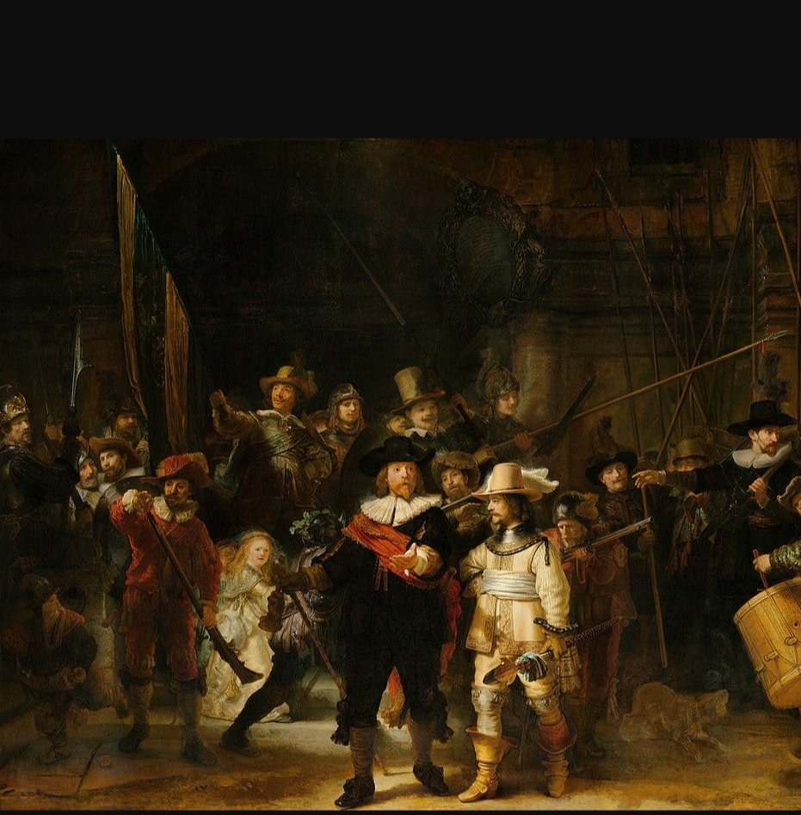
Making Us Focus
In paintings, the Masters knew how to draw our attention to a particular spot, the area on which they wished us to focus. The same is true in the Scene 9 of THP. Let's look at how Stoppard does that
Notes:
The way shadows fall across the canvas creates a sense of depth and realism, whilst adding to the drama. Rembrandt carefully studied how light struck surfaces and used that understanding to shape both mood and composition. We can apply this by using light to organise the composition, letting the less important details fall into darkness. Working in monochrome or with a limited palette, as Rembrandt often did, can help train the eye to prioritize value over color. This is important, since value is generally more fundamental to the success of a painting. We can begin by blocking in large shadow shapes first, then gradually build up the midtones and details. This structured approach strengthens the clarity and emotional coherence of our work.

Slide 65





Scene 9: Shifts In What We See

Slide 66
Technique: Characterization & Dialogue
The Use of Cliches lecture segment is here from 39:00 – 43:56
He wants us to realize how a character can convey that information by some phrase that is ‘in the lexicon’, utterly familiar to us, and in one case punily funny
Weaving in a word that will be important; e.g.,philosophy

Slide 67
Dramatic Irony
When did you suspect Catherine/Cathy was Hilary’s daughter?

Slide 68
Analogies
Prisoner’s Dilemma
Hedge Funds/Stock market
Brain Worm
Computer playing Chess
Custody Test
Others?

Slide 69

And the ending?

Slide 70
Theories of Consciousness Hilary Doesn’t Like
ALL MATERIALIST
higher-order theories
global workspace theories,
re-entry and predictive processing theories
integrated information theory
Notes:
Rather than try to start from physical principles and arrive at consciousness, IIT "starts with consciousness" (accepts the existence of our own consciousness as certain) and reasons about the properties that a postulated physical substrate would need to have in order to account for it. The ability to perform this jump from phenomenology to mechanism rests on IIT's assumption that if the formal properties of a conscious experience can be fully accounted for by an underlying physical system, then the properties of the physical system must be constrained by the properties of the experience. The limitations on the physical system for consciousness to exist are unknown and consciousness may exist on a spectrum, as implied by studies involving split-brain patients^{[9]} and conscious patients with large amounts of brain matter missing.^{[10] Wikipedia}

Slide 71
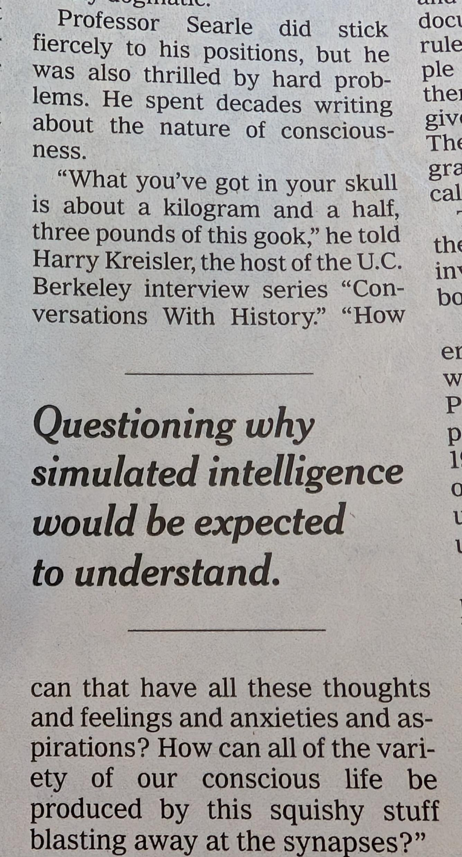
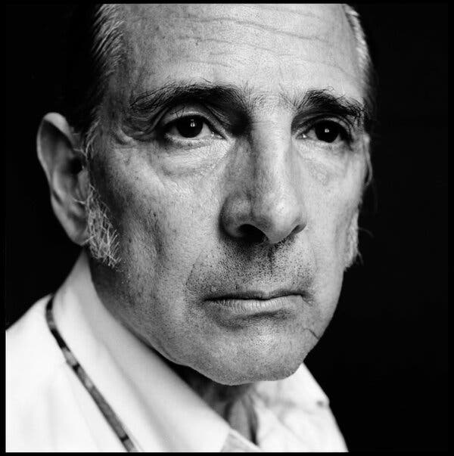
BUT John Searle (who died recently) reviewed Chalmers book as a “mass of confusions” did believe that consciousness could be explained by what was going on within the brain and Was never going to achieve consciousness
Consciousness: elusive & argued over still
His interesting and controversial obituary can be read at this link

Slide 72
Spike (and Amal) are Materialists in This Fight Like Dennett, and Our Old Friend B.F. Skinner
"It is only when machines seem to take over central processes that we grow uneasy. When they select stimuli, identify patterns, convert stimuli into forms more suitable for processing, categorize data, extract concepts, and follow problem-solving strategies, they perform functions which in man are attributed to Mind. … But the real question is not whether machines think but whether men do. The mystery which surrounds a thinking machine already surrounds a thinking man.“ BF Skinner

Slide 73
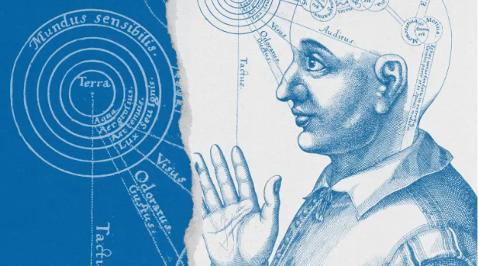
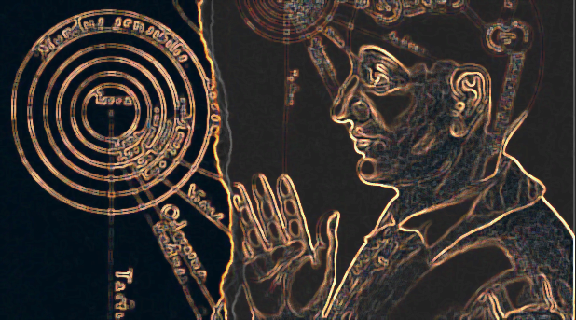
Is Mind Only Physical?
TS has more philosophical support than his critics admit; consider The Problem of Extras
"Even if all concrete phenomena obtain solely by virtue of physical phenomena, as Physicalism maintains, it seems that things did not have to be that way. The world could have been such that angels, ghosts, or other immaterial beings reside alongside the physical items that actually exist. It is also arguable that Physicalism allows non-actual possible worlds where all the actual physical laws obtain but with immaterial extras — provided that these extras do not causally interfere with the physical world. Horgan imagines that ‘[i]n such worlds the spirits would not interfere with the ordinary operations of physical laws upon physical substances; they would simply co-exist with the physical’“
Robert Francescotti, San Diego State University

Slide 74
Stoppard against a Darwinian evolution of moral rules
“What is sort of disappointing in a Darwinian, the conception of a Darwinian evolution of moral rules, what is disappointing in that for Hilary in the play is that that is not really an objective. There's no Archimedean place to stand like Archimedes levering the earth. There's no where to stand where you can actually be outside this in order to define it. It's just something that biology gives you as a legacy of some kind. And what she's basically saying is that unless there is an overall moral intelligence of some nature then we are grading our own homework. We're giving ourselves our grade morally. And I can completely sympathize with somebody who would like to believe that her choice of behavior, what she chooses between what she conceives to be good behavior and contrariwise. I completely sympathize with somebody who would like some, as it were, authentification of that choice.”
“You, we, just simply are social animals who have to make a go of things together as best we can. We need to have some, as it were, validity to what we promulgate as desirable attitudes have behaviors.”

Slide 75
Is THP Anti-Science Has TS failed to ‘subsume’ accurate thoughts and calculations?
‘Stoppard’s characters are troubled by how morality can evolve, when there are fascinating examples of altruism in chimps and a sense of justice in monkeys.” Rowan Hooper
“…in later studies, [of] prisoner's dilemma … the population tended to evolve to more generous, more like New Testament strategies 'turn the other cheek’. You find the evolution of more gradually more and more generous strategies, … the Old Testament sort of naturally led to the New Testament in the computer tournament – with no one teaching it to do so.”
“And finally, this is the ultimately disturbing part, is once the world evolves to place where everybody is playing very 'Jesus-like' strategies, that opens the door for [the player who always defects] to come back. Everyone is so nice – and they take advantage of that.”
. But what I meant when I said 'morality is self-organising' – because it's an interesting question for history: where does morality come from? And you might say morality came from God – okay, that's one kind of answer. But you could say morality came from evolution; it's natural selection, which is all we're talking about here, trying to win at the game of life. If natural selection leads to morality, that's pretty interesting. And that came from maths!"
Steven Strogatz, the Jacob Gould Schurman Professor of Applied Mathematics at Cornell University and author of Joy of X: A Guided Tour of Maths, from One to Infinity,
Notes:
I mean, the one thing that's really good about 'tit for tat' is that … the player who always defects – he can't make much progress against 'tit for tat'. But it can against the very soft, always cooperating strategies. You end up getting into these extremely long cycles going from all defection to 'tit for tat' to always cooperate and back to all defection. Which sort of sounds a lot like some stories you might have heard in history. Countries or civilisations getting softer and softer and then they get taken over by the barbarians.
Rowan Hooper article is here: https://www.newscientist.com/article/dn26878-the-hard-problem-is-stoppards-problem-with-science/

Slide 76
What's real? Begin With That Beginning: The Prisoners Dilemma
“A crucial question of evolutionary biology is how natural selection can lead to cooperative behavior. A cooperator is someone who pays a cost, c, for another individual to receive a benefit, b. Cost and benefit are measured in terms of reproductive success. The hallmark of direct reciprocity is the repeated Prisoner’s Dilemma (PD)
In the PD, two players have a choice to cooperate, C, or to defect, D. If both cooperate they receive a payoff R. If both defect, they receive a lower payoff P. But a defector versus a cooperator gains the highest payoff, T, while the cooperator is left with the lowest payoff S. The game is a PD if T>R>P>S.
In a non-repeated PD, it is best to defect. Cooperation becomes an option if the game is repeated. … Otherwise alternating between cooperation and defection would lead to a higher payoff than mutual cooperation.”
Lorens A. Imhofa, , Drew Fudenbergb, Martin A. Nowak, Prisoner’s Dilemma Tit-for-tat or win-stay, lose-shift?
Notes:
Various mechanisms for the evolution of cooperation have been proposed including kin selection (Hamilton, 1964), group selection (Wilson, 1975; Wynne-Edwards, 1962), indirect reciprocity (Nowak and Sigmund, 1998, 2005) and spatial (or network) reciprocity (Nowak and May, 1992; Ohtsuki et al., 2006; Skyrms, 2004). Here we analyze direct reciprocity which was introduced by Trivers (1971).
“…The simplest strategy is tit-for-tat (TFT), submitted by Anatol Rapoport (see also Rapoport and Chammah, 1965). TFT cooperates in the first round and then does whatever the opponent has done in the previous round. It will play C for C and D for D. Hence, TFT embodies the simple principle ‘an eye for an eye and a tooth for a tooth’. It was remarkable that TFT won both tournaments, because participants of the second tournament knew the outcome of the first and tried to design (more sophisticated) strategies that were superior to TFT.”
…TFT’s unrelenting punishment never forgives even a single deviation, but forgiveness is needed to restore cooperation after occasional errors (Fudenberg and Maskin, 1990; Molander, 1985; Nowak and Sigmund, 1992)… “…Win-stay, lose-shift (WSLS) is a very simple strategy which has neither of these two weaknesses (Nowak and Sigmund, 1993). WSLS works as follows. If WSLS receives payoff T or R it will repeat the same move next round, this is ‘win-stay’. If WSLS receives only payoff P or S, it will switch to the opposite move, this is ‘lose-shift’. Thus, the choice of the next action is based on some aspiration level which lies between P and R.”

Slide 77

Motherhood and trade-offs
Tom Stoppard’s The Hard Problem (2015) from Kathleen R. Hart
Hart writes about how the play offers “a unique window onto two types of biases that affect people contending with Sarah Hrdy’s revelation that women weigh the costs as well as benefits of nurturing”

Slide 78
Stoppard and Hilary 'Kant' Help Getting Metaphysical: Justin Smith-Rhiu Offers Context
"In the late 18th century, Immanuel Kant noticed that there are certain domains of human inquiry that seem hopelessly mired in confusion, in ungrounded conjecture and speculation, notably those concerning knowledge of transcendental truth about God, for example, or about the ultimate ends or purposes of natural processes. ... Kant maintained that human beings are simply constrained, whether we like it or not, to wish to have knowledge in these domains, and it is no less irresponsible on the part of philosophers to say that they want nothing to do with such knowledge, as the skeptics do, than it is for them hastily and prematurely to claim that they have solved all the problems in these domains, as the dogmatists do, or that the problems encountered in these domains are unimportant or even nonsensical, as the logical positivists will do soon enough"
"In the early 20th century metaphysics became a bad word for many philosophers, who took a very uncontained view and simply insisted that a domain so often mired in sloppy speculation and vague metaphor is one that is unworthy of the attention vigorous philosophers. Did metaphysics go away then? Of course not. It mostly just migrated into the new age sections of bookstores and became focused on esoteric topics like crystal healing and UFO sightings, rather than on the continuous tradition that descends from Aristotle's treatise known as The Metaphysics. This is the common result of efforts to suppress entire dimensions of human experience and human curiosity: they are never really suppressed but only pushed out to the margins and left to the undisciplined and unhinged."

Slide 79
the human brain is subject to bouts of unreason which are which are hard to explain through purely physically explanations
Explaining unreason in two themes
Nick Hytner to TS: “You want to write about evolutionary biology and the banking crisis. You do draw this very striking analogy between the unreason, which to many people is surprising, the unreason of the market, the irrational exuberance and indeed the irrational Panic of the market and the way the human mind, the way the human brain is subject to bouts of unreason which are which are hard to explain through purely physically explanations.”
Shakespeare suspected reason as well especially in the tragedies
“Shakespeare’s tragedies also try to make their audiences think. In particular, to make them think about the status of human thought as an ineradicably emotional phenomenon that is far from being the province of an unblinking and dispassionate rationality. The Shakespeare of the tragedies goes beyond the familiar claim that reason is the slave of the passions, and asks us to infer that reason as we tend to discuss it is the invention of the passions—of our desperate need to feel that we understand, or have the capacity to understand, our earthly lot. In so doing, he does not imply that the mental phenomenon represented by the word “reason” (something like “the power of intelligence through which human beings process the world”) does not exist, but that reason as generally understood is a heuristic—a fiction that the human mind has settled upon in the attempt to explain itself to itself.”
Rhodri Lewis’s book Shakespeare’s Tragic Art

Slide 80
"Goodness is something that has always interested you" Nicholas Hytner
“...when starting to write this play, Tom wrote, ‘I want to write a character who is good, not goody-goody ,and believes that goodness has an objective reality which is not captured by, explained by, defined by evolutionary science by evo-psychology, Evo biology, by Neo Darwinism. The character is a young woman who's in her early 20s at the beginning of the play; the timespan is about 10 years, Circ 1999 to 2008. The setting is based on some place like the Allen Institute in Seattle, but we're in England. Paul Allen ex-Microsoft has financed a brain science lab to investigate how brains work etc. The play's dates are to accommodate my my hazy notion that my Allen is a hedge fund guru and that the credit crunch is where we're heading. So, a play about evolutionary biology and the banking crisis. happy Christmas! ‘

Slide 81
Goodness Gracious!
So, goodness. OED has the oldest definition as “The quality of being morally good; virtue; worthiness.” And morally? OED again: “In respect of moral character or conduct; from the point of view of morality; with reference to moral responsibility.” But we’re in danger of getting tautological here: “Of an argument or definition: merely restating in different words the very thing which is to be explained, shown, or defined” So, what is morality? Is there one answer? Stoppard in that same interview says, “it just seems to me that the idea of real morality is unintelligible without Consciousness.” The clash is between the idea that goodness is learned behavior and the premise that goodness is more ineffable, intrinsic, not just aping our adults.
For Stoppard and our lead character, Hilary, the idea of goodness is “personal very subjective sense of what is adequate to the agony and Ecstasy of human life.”

