Slide 1
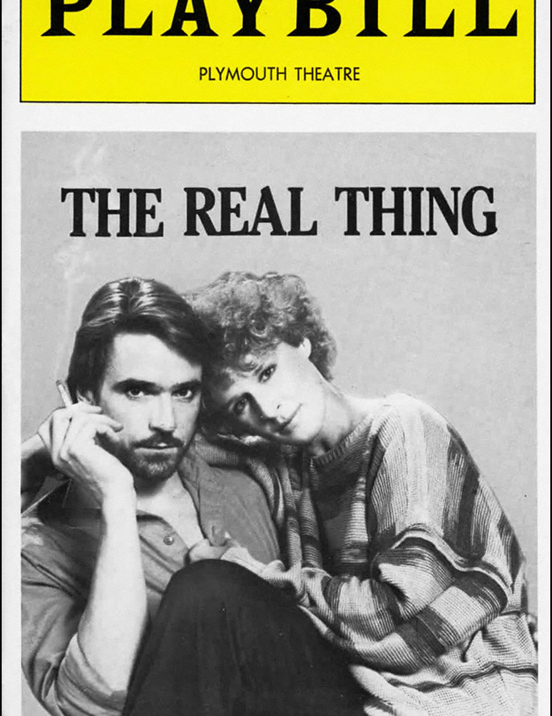

Thought and Calculation: Examining Tom Stoppard’s Theatrical Invention in 3 Plays: The Real Thing
Session 2
October 15, 2025
1:30 – 3:30 PM

Slide 2
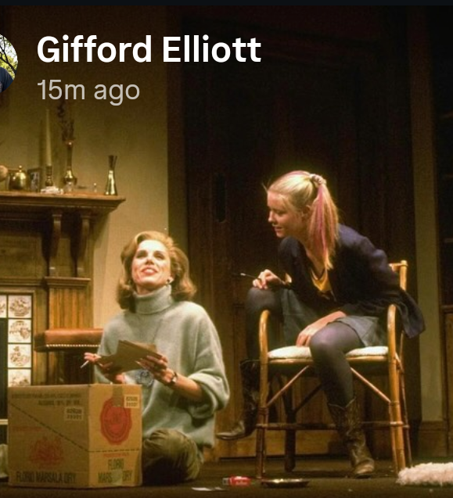
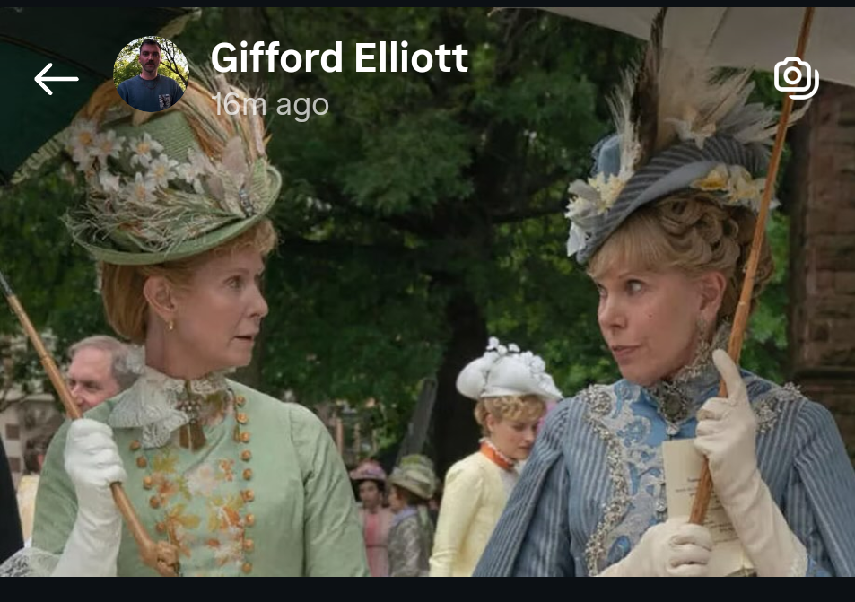
The Real Thing Carousel
1984
Broadway
2025 The Gilded Age

Slide 3
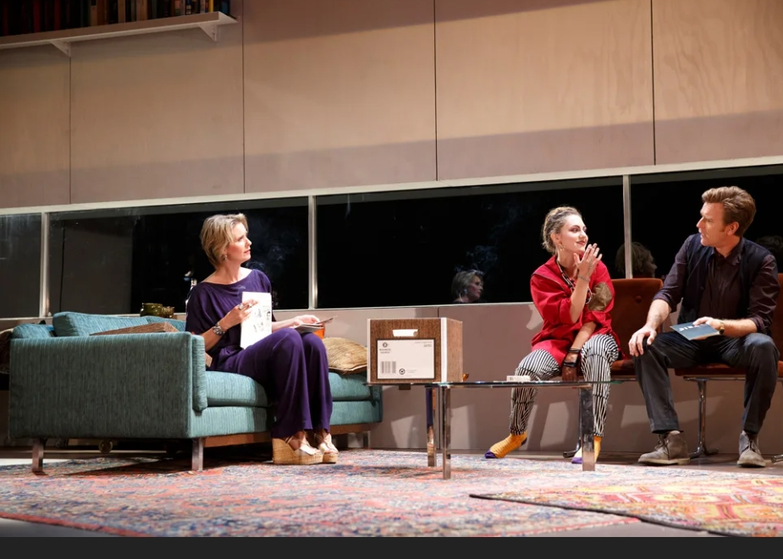
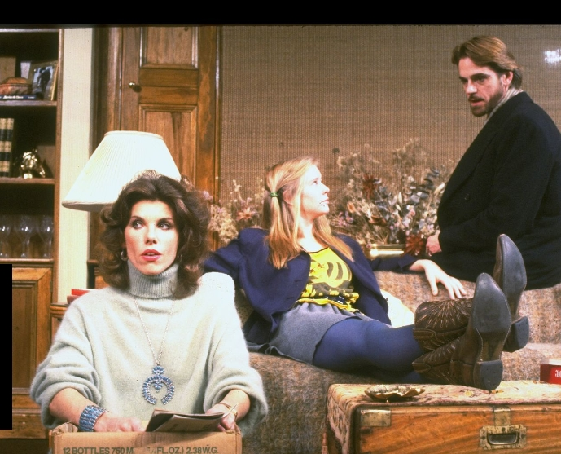
The Real Thing Carousel
2014
Broadway
1984
Broadway

Slide 4
Scene by Scene: Act I
Scene 1: The play within a play: Max confronts, his wife, Charlotte accusing her of having an affair because she lied about going to Geneva for a business trip, having left her passport behind. Charlotte confesses nothing and leaves with her suitcase.
Scene 2: The play proper: Henry and Charlotte, the actress in the faux play, are a real married couple. The play is one Henry wrote called A House of Cards. At their home, they are joined by Max (the actor) and his wife, Annie (also an actress as well as a passionate political activist). After the others step out, Henry and Annie reveal they are having an affair.
Scene 3: The parallel structure is reinforced as Max discovers Henry's handkerchief, leading him to confront Annie with a betrayal that mirrors the fictional play. This time, the heartbreak is real. Max is devastated, and Annie leaves him for Henry
Scene 4: Annie and Henry are together but in messy diminished circumstances. He can't ‘write love’ even though he promised he a play in that theme. But he says he loves her so despite not being able to show the jealousy that she thinks he should muster.

Slide 5
Scene by Scene: Act II
Scene 8: Billy and Annie "She returns the kiss in earnest"
Scene 9: Scene 1 turned inside out with Henry and Annie playing it for real this time.
Scene 10: Billy and Annie doing the Brodie play as rewritten by Henry with hint of detachment by Annie.
Scene 11: Henry and Annie parsing infidelity
Scene 12: Brodie, released from prison, comes to Henry and Annie's home. He berates Henry forchanging his play and acts entitled, only to have Annie throw a bowl of dip at him in a burst of anger. Henry receives a call from Max, who is getting married again.
Scene 5: Henry and Annie argue about 'political prisoner' Brodie. Henry agrees – condescendingly-- to rewrite Brodie's poorly written play. And.. The cricket bat speech
Scene 6: Annie rehearses TPSAW with young, attractive actor named Billy with a flirtatious, perhaps suggestive, subtext to their scene.
Scene 7: Henry, Charlotte, and daughter Debbie. Debbie who is about to take a road trip disputes Henry about sex, infidelity, and life. Henry talks about love as knowing and being known. Charlotte returns and reveals that it used to bother her that Henry was never bothered. "There are no commitments, only bargains and they have to be made every day."

Slide 6
Our Steps
What’s going on here in this play?
What thoughts — ideas, calculations, themes — did you perceive as part of the play TS constructed?
How did he manage to “subsume thought and calculation into the interior of” the story?
Where would TS 'have us stand? Or with whom?
Irony anyone? Contradictions?
How would you characterize your post-reading or viewing experience?
Did you have questions afterwards?
What scenes do you think merit our particular attention?

Slide 7
What Inspired TRT?
MG: I‘m still not clear what inspired The Real Thing beyond the fact that the first scene was to have been written by someone in the second scene.
TS: It's quite hard to remember. I can only remember two things. One was what you just said: the same situation recurs a couple of times in different circumstances, so that it's played differently. The other was what I mentioned in England, that public attitudes are a kind of mirror of a private disturbance. People in the play take certain public postures which are connected with what the play calls a private derangement. Half of the impetus for night and day was to write about love and marriage, and I guess the play went back to that
[The highlighted section is actually a quote from Auden that Stoppard cited, which may not be Auden’s!!!]

Slide 8
Biographical Fallacy or Taking Everyone’s Side
“Because The Real Thing had an English playwright editorializing about writing and love and marriage and all that, it was perfectly obvious that when he was waving his prejudices around, he was pretty much speaking for me. But then so are the other people (in the play) contradicting him. That’s what playmaking is; you have to take everybody’s side.” Tom Stoppard quoted by Hermione Lee in her biography of him from 1972
Father James Conlon taught me the same principle in a playwrighting course in 1973: you must love or at least value all your characters even though they may be hateful or ridiculous to the audience

Slide 9

What is Stoppard trying to explore here? How does TRT move towards those goals? You first! Then Stoppard and some others have a go

Slide 10
What's real?
Henry: "Politics, justice, patriotism... there's nothing real there separate from our perception of them"
"There are no commitments, only bargains and they have to be made every day.“
…”I could write the real stuff”
“Tom Stoppard explores the nature of illusion in The Real Thing: What constitutes reality in love, art, and politics? The Real Thing originated as a structural challenge for Stoppard: “This play wasn’t written in order to say certain things about writing,” he says. “It was written because I liked the idea of the game, the device of having the same thing happen two or three times.”
In constructing this game with its “slippages between textual and lived reality”, Stoppard references other works tackling the same issue to both challenge narrative perception and use literature as a method for understanding one’s own experience.

Slide 11
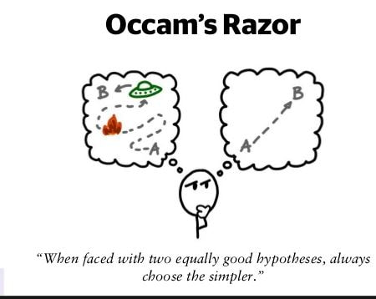
Illusion versus Reality: Applying Occam’s Razor to TRT
“Ostensibly, The Real Thing poses the question, through countless examples of illusion and reality, of what is real? In doing so it is asking the audience to use its own Occam’s razor to sift illusion from reality, usually in a rapid way. Very soon into Act 1, scene 2 one needs to have worked out that scene 1 is not real; it’s a play. It is necessary to note the deliberate similarities between the appearance of Annie and Charlotte, when both enter dressed in Henry’s clothes, and the self-referral between the real and the illusory in Henry’s jealous rifling of Annie’s possessions versus that of Max’s search through Charlotte’s things in House Of Cards. Brodie’s play about two people meeting is on a train is similar to that of Annie and Billy actually meeting on a train. Annie and Billy rehearse. But, when they rehearse Tis Pity She’s A Whore and Brodie’s play, it’s because they are really in love. While talking on the train Annie and Billy suddenly get transposed into Ford’s Giovanni and Annabella. Furthermore, Charlotte’s virginity is lost in real life to the actor who took the virginity of her character, Annabella, in a touring production of Tis Pity She’s A Whore.” Nigel Purse
So, is it just a play about illusion and reality? Or something more?

Slide 12
Knowing What’s Real
…The Real Thing appears to be a play asking Henry to sift illusion from reality when it comes to finding the real thing, the true meaning of love. But, he does not find it easily because he gets confused with all different sorts of love (from carnal knowledge to free love to being ‘the last romantic’), mostly in conversation with his ex-wife Charlotte and their daughter: In response to Annie’s challenge that, ‘You have to find a part of yourself where I’m not important to you’. Henry is forced to realise that what love really means to him is that, ‘I can’t find a part of myself where you’re not important’.
There is no apparent agreement at the end as to what the real thing is in terms of love [or fidelity or marriage]. The resolution of the meaning of the real thing, as love, seems to come down to one thing: Debbie’s claim that, ‘Exclusive rights isn’t love. It’s colonization’.
Henry appears to accept this view when confronting Annie over Billy: “Dignified cuckoldry is a difficult trick, but it can be done. Think of it as a modern marriage. We have got beyond hypocrisy, you and I. Exclusive rights isn’t love, it’s colonization.” [And again he’s quoting his teenage daughter: is he being real?]
Stoppard reinforces the point in a letter to Gordon Davidson, at the same time noting that most actresses find Annie’s decision on which of her lovers she should hurt counter intuitive” Nigel Purse

Slide 13
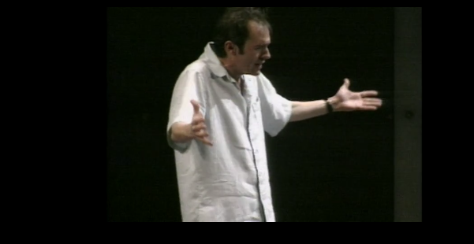
Let’s watch a Scene 4: Developments in the SECOND actual, THIRD depicted marriage in TRT
This scene is from the Jennifer Ehle & Stephen Dillane 2000 production
Start to 2:07

Slide 14
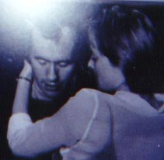
A Little More On Stoppard and Love from Belinda Jack
“In treating love, the dangers of sentimentalism and of cliché, are great. Stoppard avoids these by refusing to write love into the language of the play. The crucial expression of love is not linguistic, but gestural. It is the affirmative gestures that Henry and Annie exchange that communicate love. At the end of Act 1, the stage direction reads: ‘He goes to the door to leave. At the door he looks at her and nods. She nods at him. He leaves.’
And at the end of scene eleven, the penultimate scene of the play the stage direction reads: ‘He nods at her. She nods back and leaves’.
These are private and secret exchanges. And if love is to be expressed in the play, the actors have to get these nods right.
The audience has to ‘sense’, to ‘feel’ their love – not to hear it expressed in words.
And Stoppard’s reluctance to theorise love in the theatre is part of his more general suspicion of theorizing theatre.”

Slide 15
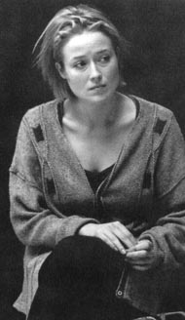
Is Annie The Real Thing?
Jennifer Ehle on Annie: “Her character is adored by her first husband, worshiped by her playwright husband, and the object of lust of every other male character in the play. In rehearsal, I began to realize that every man in this play is fixated with her. And you know what? It's great fun, and quite liberating! But what I love about Annie is that she's not limited by the things about her that enable men to fixate on her. It's quite rare -- she's flawed, she's real, she's still loved -- and she was written by a man."

Slide 16
Is Sex The Real Thing? Love?
SEX
LOVE
Debbie: “When I was twelve I was obsessed. Everything was sex. Latin was sex. The dictionary fell open at ‘meretrix’, a harlot. You could feel the mystery coming off the word like musk. ‘Meretrix’! This was none of your mensa-a-table, this was a flash from a forbidden planet, and it was everywhere. History was sex, French was sex, art was sex, the Bible, poetry, penfriends, games, music, everything was sex except biology which was obviously sex but not really sex, not the one which was secret and ecstatic and wicked and a sacrament and all the things it was supposed to be but couldn’t be at one and the same time — I got that in the boiler room and it turned out to be biology after all.”
Henry: “I love love. I love having a lover and being one. The insularity of passion. I love it. I love the way it blurs the distinction between everyone who isn’t one’s lover. Only two kinds of presences in the world. There’s you and there’s them. I love you so.”

Slide 17
“Whosit knew so-and-so. Carnal knowledge. It’s what lovers trust each other with. Knowledge of each other, not of the flesh but through the flesh, knowledge of self, the real him, the real her, in extremis, the mask slipped from the face. Every other version of oneself is on offer to the public. We share our vivacity, grief, sulks, anger, joy … we hand it out to anybody who happens to be standing around, to friends and family with a momentary sense of indecency perhaps, to strangers without hesitation. Our lovers share us with the passing trade. But in pairs we insist that we give ourselves to each other. What selves? What’s left? What else is there that hasn’t been dealt out like a pack of cards? Carnal knowledge. Personal, final, uncompromised. Knowing, being known. I revere that. Having that is being rich, you can be generous about what’s shared – she walks, she talks, she laughs, she lends a sympathetic ear, she kicks off her shoes and dances on the tables, she’s everybody’s and it don’t mean a thing, let them eat cake; knowledge is something”
Is This Knowledge The Sine Qua Non of The Real Thing?

Slide 18
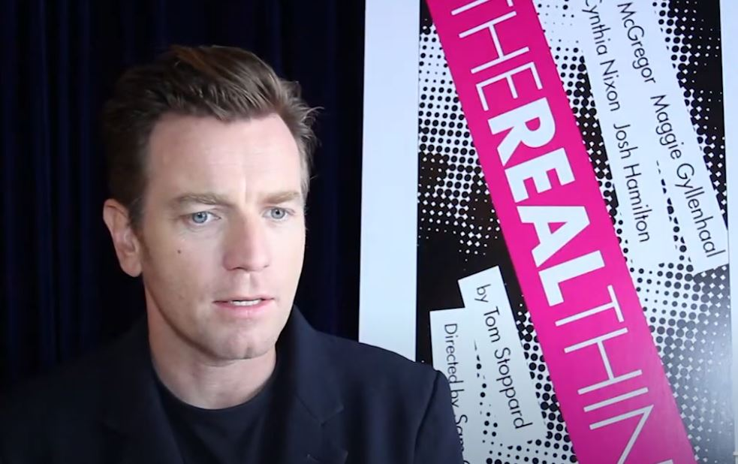
Is Fidelity The Real Thing?
A 2:25 Interview With Cast members of the 2015 TRT revival

Slide 19
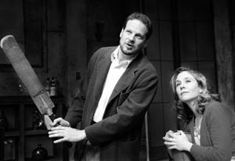
Is The Real Thing Authenticity?
“The cricket bat speech is about authenticity: what does the job, what rings true? It applies to language: how good can it be, what are the tests for its authenticity? And it also applies to love. How do you know the real thing? How do you keep it? And how do you write it? Henry is on shakier ground here. “I don't know how to write love,” he tells his lover. “I try to write it properly, and it just comes out embarrassing.” Stoppard likes this self-referential moment: in a play about love, his playwright complains that that is what he can't write about.”
Hermione Lee in her Stoppard biography

Slide 20
Self Knowledge Through Pain: Let’s Look at Scene Seven
Page 61-63 in script
“The Real Thing was a play about breaking faith—but also about keeping the faith. Its author was a faithful friend to those he loved, and faithful to his past.” Hermione Lee
Debbie: What, House of Cards? Well, it wasn't about anything, except did she have it off or didn't she? What a crisis. Infidelity among the architect class period again
Henry: It was about self knowledge through pain.
Debbie: No, it was about did she have it off or didn't she. As if having it off is infidelity.
Let’s contrast the arguments about sex and knowing of Debbie and Henry with a little reading

Slide 21
Is The Real Thing Not A Thing At All But A Way Of Being, of Equilibrium?
“Equilibrium is pragmatic. You have to get everything into proportion. You compensate, rebalance yourself so that you maintain your angle to your world. When the world shifts, you shift.” When the world shifts... When your sense of what is real shifts seems to be what he is saying. Hermione Lee in her biography of Stoppard states firmly that this line “is the fulcrum of all the plays images of balance: the fragile structure of the House of Cards, the concrete platform that can take any strain, the words that can' build bridges across incomprehension and chaos, ' the tilt you may be able to give to people's perceptions ' at that axis where we locate politics or justice,' the construction of a cricket bat. To make the best use of the bat, you have to stand steady, shift your weight, hold your balance. Like a pyramid of acrobats, or a suspension bridge, or the' leverage' Archimedes needs to move the world, or the impossibility of squaring the circle, the application of geometry to engineering is his favorite tactic for asking what will work? It's the most resonant, and possibly the most autobiographic, lying in this eloquent play about emotion.”
Does this make sense to you? Is there some other part of the play that you think has a better claim to representing its central thesis? What do you think that central thesis is? And true to our premise how good a job has Sir Tom done in weaving it into the story?

Slide 22
In TRT, Political stances turn out not to be real as opposed to private ones
“Entire generations falsify themselves; that is to say, they wrap themselves up in artistic styles, in doctrines, in political movements, which are insincere and which fill the lack of genuine conviction.
The principle of parsimony does apply to The Real Thing if one accepts that this is what the key issue in the play is – because its resolution is very concise, when stripped of all the extraneous noise of relationships and the complications inherent in the mask of illusion and reality that derives from it.
The play very clearly questions the sincerity of the motivations of the publicly held (especially political) positions and beliefs of its protagonists. They are shown in The Real Thing to be a sham.”
Nigel Purse

Slide 23
Let’s Have Tom Tell Us What He Thinks
Charlie Rose: Right. There's so much I want to talk to you about because, as always-- and even though we've had all these sessions together, I-- there are constantly new ideas that I want to explore. Just tell me what The Real Thing is about.
Tom Stoppard: It is about-- it's certainly about love. It's partly about writing because, as you know, the protagonist is a playwright, something I tried to avoid but failed to avoid.
Let’s join the interview a little later at 9:04 and continue for several minutes to 12:54
Here’s the link

Slide 24
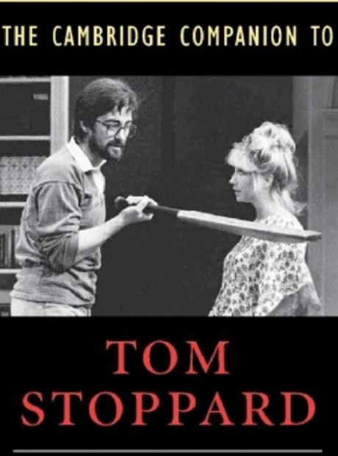
Foregrounding Analogies Callbacks Dramatic Irony Comic Misunderstanding Puns & Wordplay
Let’s Look at Some Craft Used in TRT

Slide 25
Technique: The Faux Play
“The play-within-the-play always serves two functions – to comment on the events of the central narrative and to comment upon the nature of dramatic signification (often the commentary on the central narrative is channeled through the commentary on dramatic signification).” Jeffrey R. Wilson
What is the relationship of the two plays – the play-proper and the play within the play?
Why is the play-within-the-play is staged? How does it serves to advance the central narrative?
What do you make of the author of the play-within-the-play being an architect? What is the relationship of the narrative of the play-within-the-play to the central narrative of the play-proper?
BONUS: Do you see the foreshadowing of a reversal that adds an emotional element to the subsequent events of the play-proper?

Slide 26
Comic Ambushes: Serious Stuff Delivered Farcically
“The entire panoply of Stoppard's trade-mark comic devices is abundantly present in the (first) scene: witty puns, elegant jokes, comic misunderstanding. Here is Max, for example, launching into along, funny, seemingly irrelevant encomium on the superiority of Swiss watches:
And they've done it without going digital, that's what I admire so much. They know it's all a snare and a delusion. I can remember digitals when they first came out. You had to give your wrist a vigorous shake like bringing down a thermometer, and the only place you could buy one was Tokyo. But it looked all over for the fifteen-jewelled movement. Men ran through the marketplace shouting, "The cog is dead." But still the Swiss didn't panic. In fact, they made a few digitals themselves, as a feint to draw the Japanese further into the mire, and got on with numbering the bank accounts. And now you see how the Japs are desperately putting hands on their digital watches. It's yodelling in the dark. They can yodel till the cows corne home. The days of the digitals are numbered.
The scene is, moreover, cunningly patterned and allusive, another Stoppardian signature. Stoppard opens his play by deliberately echoing the close of Ibsen's A Doll's House, the most reverberating door-slam in all of drama. Charlotte's entrance on this fateful day, like Nora's exit, thus symbolizes the shattering of a marriage; the structure of Max and Charlotte's life together falls apart in front of our eyes, as surely as Max's house of cards collapses.” Hersh Zeifman, Comedy of Ambush: Tom Stoppard’s The Real Thing
And it’s not a real marriage

Slide 27
The Situation Being Repeated Three Times
“He opens the play with a scene… sleight of hand, but this theatricality does so much more, presenting as it does a scene of love and betrayal that is intentionally ‘theatrical’. The dialogue is too clean and witty – not quite the real thing.
Later a much sloppier kind of confrontation between a ‘real’ couple in the play, but it too fails to satisfy, given that it feels like the stylized inarticulation of a method-acted kitchen sink play.
Then, toward play’s end, yet another scene of confrontation. It is muted but devastating, and it fails fully to offer ‘real ‘ closure, providing neither tidy clichés of urbane wit nor the drivelling gutterings of an inarticulately devastated lover. William W. Demastes
Is Stoppard’s 3rd option the ‘real’ thing? Is anything in the play actually ‘The Real Thing’, or just a ‘a mediated (re)presentation of whatever it is that betrayal ‘really’ looks like’?
“I'm really not a very exploratory writer. I don't pick up a pen and see how things will go. By the time I pick up a pen, I've gone through so much work. Once I have the vague idea of the structure, landmark moments occur which fit into the structure . I have an idea of how the scene will end, but I don't know how to get there. In The Real Thing, one of the stimuli has to do with the situation being repeated three times. That gave me two landmarks to head for. “ [Contradiction alert?]
Note that this iterating, ‘repeated use of a formula by substituting in it each time the result of the previous application’ will appear in Arcadia as well

Slide 28
The Situation Being Repeated Three Times
Belinda Jack: “When Annie returns home from Glasgow she discovers that Henry has ransacked the flat looking for signs of her infidelity. His confrontation with Annie echoes the scene from his play, The House of Cards but Annie has a good bit more to say than the wife of the play.”
Henry opens a present from Annie then: “a tartan scarf—another fabric item that pointedly replaces the handkerchief as a symbol of betrayal. Unlike the character in his play, Henry does not laugh at the irony. His intense pain is real, showing the emotional difference between life and theatre, even as life begins to imitate art. ”
Hersh Zeifman
What is the import of that difference? Is TS taking us into the ‘real’ of relationships as he sees them by having Annie confess that she is emotionally entangled with her co-star Billy, but not in a physical manner? The comparison with the first scene makes us see the difference between the contrived flatness there with (as Charlotte accused Henry in the second scene skewed towards giving the mail all the best lines and this scene that appears more 3-dimensional, more real, less scripted?

Slide 29
Callbacks: Scene Seven
Both from Debbie
“When I was twelve I was obsessed. Everything was sex. Latin was sex. The dictionary fell open at ‘meretrix’, a harlot. You could feel the mystery coming off the word like musk. ‘Meretrix’! This was none of your mensa-a-table, this was a flash from a forbidden planet, and it was everywhere. History was sex, French was sex, art was sex, the Bible, poetry, penfriends, games, music, everything was sex except biology which was obviously sex but not really sex, not the one which was secret and ecstatic and wicked and a sacrament and all the things it was supposed to be but couldn’t be at one and the same time — I got that in the boiler room and it turned out to be biology after all.”
Exclusive rights isn’t love, it’s colonization

Slide 30
Callbacks: Scene Eleven
HENRY: Dignified cuckoldry is a difficult trick, but it can be done. Think of it as modern marriage. We have got beyond hypocrisy, you and I. Exclusive rights isn't love, it's colonization.
ANNIE: Stop it—please stop it. (Pause)
HENRY: The trouble is, I can't find a part of myself where you're not important. I write in order to be worth your while and to finance the way I want to live with you. Not the way you want to live. The way I want to live with you. Without you I wouldn't care. I'd eat tinned spaghetti and put on yesterday's clothes. But as it is I change my socks, and make money, and tart up Brodie's unspeakable drivel into speakable drivel so he can be an author too, like me. Not that it seems to have done him much good. Perhaps the authorities saw that it was a touch meretricious. Meretrix, meretricis. Harlot.
ANNIE: You shouldn't have done it if you didn't think it was right.
HENRY: You think it's right. I can't cope with more than one moral system at a time. Mine is that what you think is right is right. What you do is right. What you want is right. There was a tribe, wasn't there, which worshipped Charlie Chaplin. It worked just as well as any other theology, apparently. They loved Charlie Chaplin. I love you.
Both from DEBBIE!!
What Does That Do To The Audience?

Slide 31
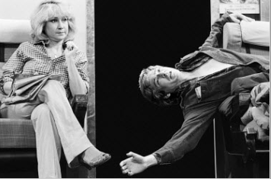
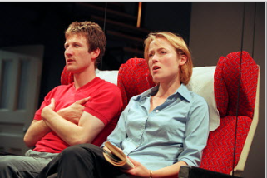
Dramatic Irony
We know that Henry and Annie are having an affair, but Charlotte and Max do not
Later we know — but Henry does not — that Annie takes as a lover Billy her “22-ish” co-star in Tis Pity She’s A Whore
What does this knowledge do to us as the play unfolds to the last scene?
How is this helping to subsume the thought and calculation?

Slide 32
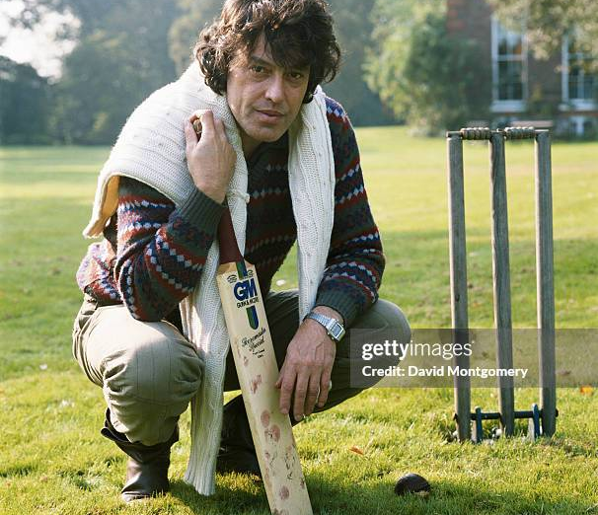
The Cricket Bat Analogy: Is the Play about Writing? Writers? Stoppard? Or The Game Within The Game?
TS: This play wasn't written in order to say certain things about writing. It was written because I liked the idea of the game, the device of having the same thing happened two or three times MG: But it does deal more directly with theater than your other plays. TS: Yes. But once you're stuck with him being a playwright who wrote the first scene, whatever narrative you invent would be about his life MG: He doesn't have to be married to two actresses. TS: He does, you see . MG: Not all playwrights are. TS: I'm not talking about that. I'm talking about my scheme, my idiotic game, a play where it turns out a woman is married to the man who wrote the first scene . If the writer's wife has got to be in both situations, she's got to be an actress. It's determined by the playful idea of having people repeat their situation in fiction.

Slide 33
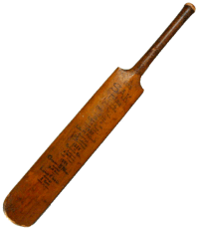
Scene Five
“I don’t think writers are sacred, but words are. They deserve respect. If you get the right ones in the right order, you can nudge the world a little or make a poem which children will speak for you when you’re dead.”
How do these these three sentences land when taken in the context of Henry and Annie’s argument?
Annie in defending Brodie tags her playwright husband a snob, arguing that his concept of “good writing” is warped:
“You judge everything as if everyone starts off from the same place, aiming at the same prize. Eng. Lit. Shakespeare out in front by a mile, and the rest of the field strung out behind trying to close the gap. You all write for people who would like to write like you if only they could write.”
Does Annie have a point?

Slide 34
Scene Five (continued)
This [cricket bat] here, which looks like a wooden club, is actually several pieces of particular wood cunningly put together in a certain way so that the whole thing is sprung, like a dance floor. It’s for hitting cricket balls with. If you get it right, the cricket ball will travel two hundred yards in four seconds, and all you’ve done is give it a knock like knocking the top off a bottle of stout, and it makes a noise like a trout taking a fly… (He clucks his tongue to make the noise.) What we’re trying to do is write cricket bats, so that when we throw up an idea and give it a little knock it might... travel… (He clucks his tongue again and picks up [Brodie’s] script.) Now, what we’ve got here is a lump of wood of roughly the same shape trying to be a cricket bat, and if you hit a ball with it, the ball will travel about ten feet and you will drop the bat and dance about shouting ‘Ouch!’ with your hands stuck into your armpits. (indicating the cricket bat) This isn’t better because someone says it’s better, or because there’s a conspiracy by the MCC to keep cudgels out of Lords. It’s better because it’s better. You don’t believe me, so I suggest you go out to bat with this and see how you get on. [he reads] ‘You’re a strange boy, Billy, how old are you?’ ‘Twenty, but I’ve lived more than you’ll ever live.’ Ooh, ouch! (He drops the script and hops about with his hands in his armpits, going ‘Ouch!’)
Did Henry (Stoppard) convince you?

Slide 35
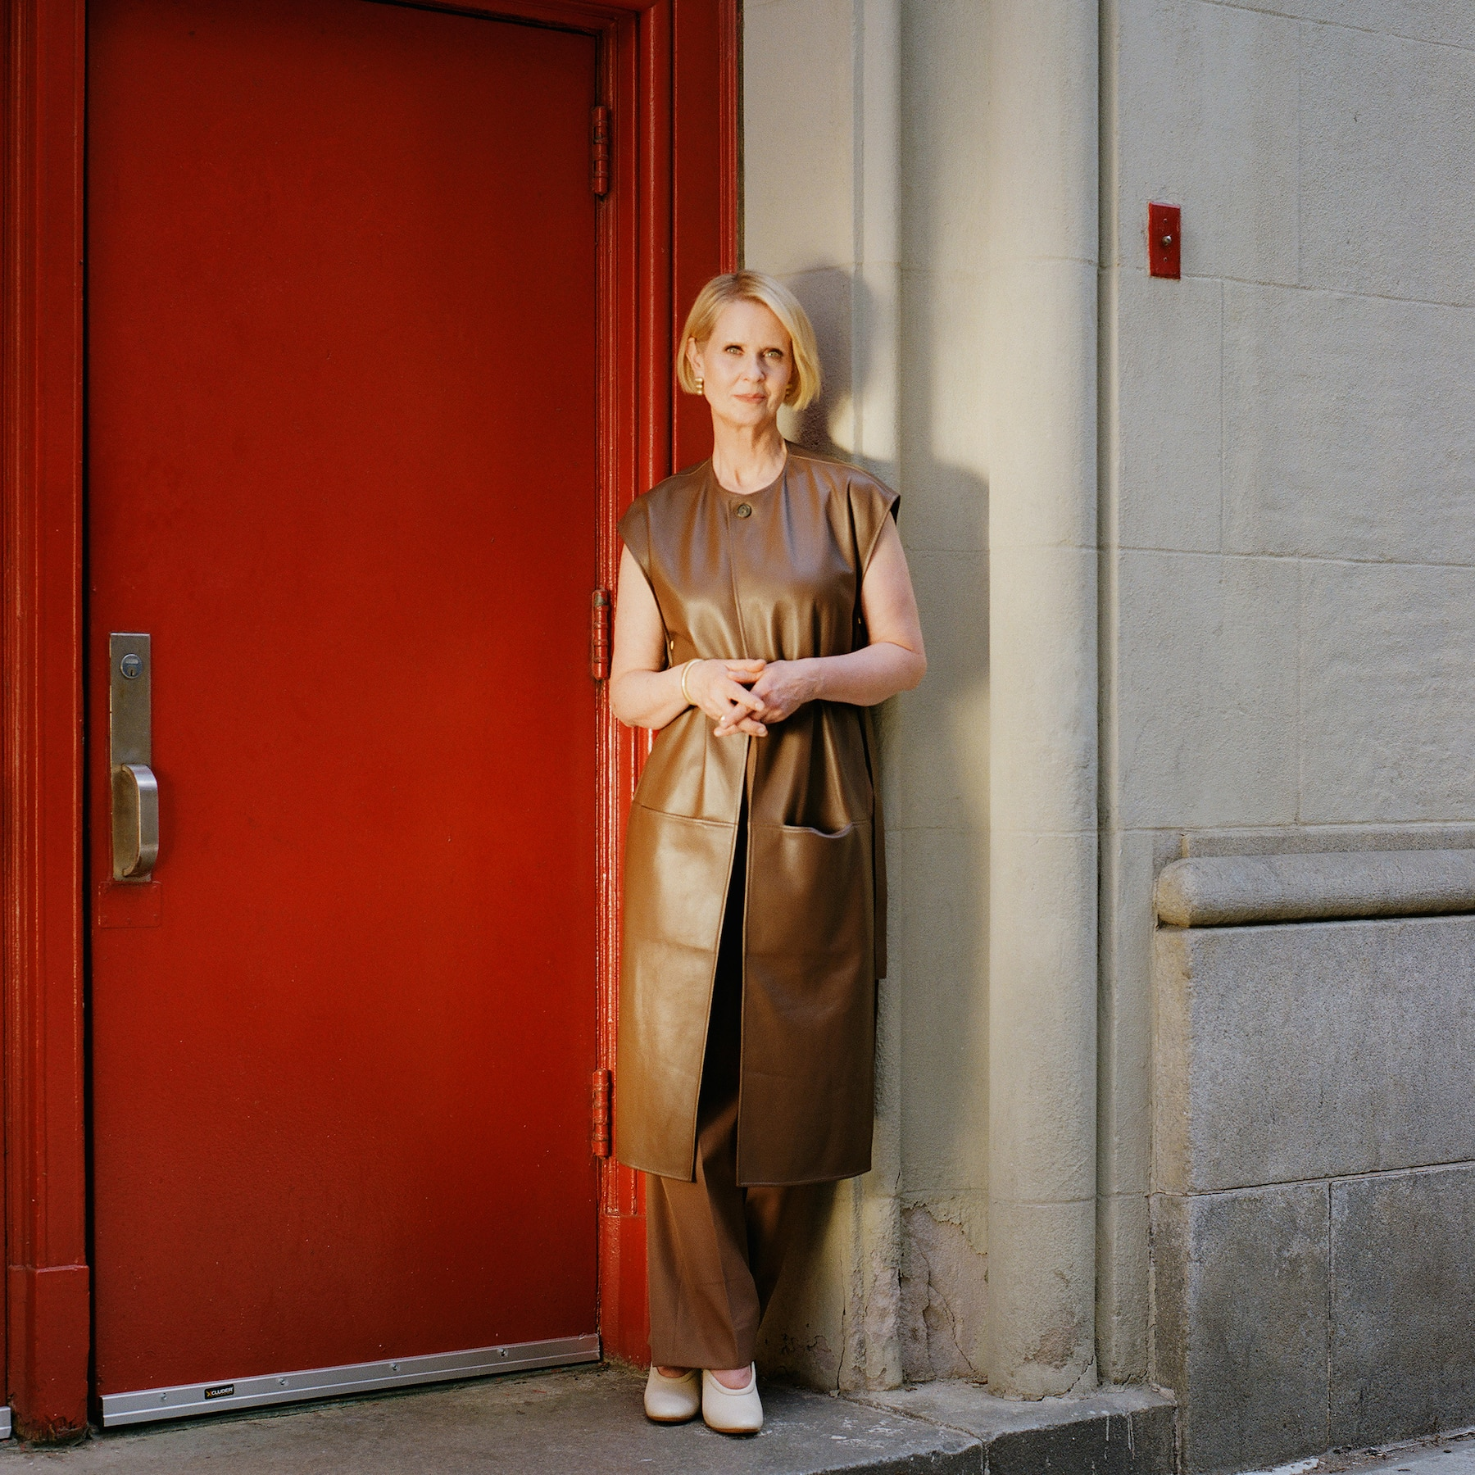
Analogies and Allusions
A handkerchief taken as proof of infidelity. Any other plots in plays come to mind using that device?
A door slamming as a wife enters, not exits, and a house collapses. Charlotte as the inverse of…
Henry James wrote a short story entitled The Real Thing: “The real passion of my life was detestation of the amateur.” Shades of our Henry and his contempt for Brodie: “Brodie … everything he builds is jerry-built. It's rubbish. An intelligent child could push it over. “ What was going on for TS that made this such a passion to weave into TRT?
He has Henry say in Act II: “If Charlotte made it legal with that architect she’s shacked up with, I’d be writing the real stuff.” I've added the emphasis here, but the use of the phrase the real stuff is not accidental. There is the real thing in love and there is the real thing in art and what he seems to be saying here is that in both cases there has to be a submission of yourself in order for it to be real, self revelation, sharing of what matters, what you value.
A door ready for slamming

Slide 36
Intertextuality In The Real Thing
“Tom Stoppard explores the nature of illusion in The Real Thing: What constitutes reality in love, art, and politics? The Real Thing originated as a structural challenge for Stoppard: “This play wasn’t written in order to say certain things about writing,” he says. “It was written because I liked the idea of the game, the device of having the same thing happen two or three times.” In constructing this game, Stoppard references other works to both challenge narrative perception and use literature as a method for understanding one’s own experience.”
Excerpts from August Strindberg’s Miss Julie and John Ford’s ‘Tis Pity She’s a Whore figure prominently in The Real Thing. The play’s other literary tributes range from obscure to obvious—Stoppard borrows plot devices and paraphrases dialogue from Shakespeare, John Osborne, Noel Coward, George Gershwin, and Oscar Wilde, to name a few.”
Lauren Halvorsen
WHY? What do you think this does to the theatrical experience?
Notes:
Intertextuality—or the way in which texts gain meaning through referencing other written work—is a recurring concept in the Stoppard canon; his plays Rosencrantz and Guildenstern Are Dead and Travesties reference and re-contextualize the work of others (Shakespeare, Albee, T.S Eliot, Beckett, et al.), to create a new, richly layered work. As scholar Kinereth Meyer notes, Stoppard’s intertextual flourishes are used not to show off his gamesmanship (as some have claimed) but to “reaffirm the validity of literature in the human experience,” allowing Stoppard to "frame deeply personal considerations of human action, its motives and limitations and values," especially among characters who are playwrights and actors themselves.

Slide 37
Here’s What Lauren Concludes About This Intertextuality in TRT
“Intertextuality—or the way in which texts gain meaning through referencing other written work—is a recurring concept in the Stoppard canon; his plays Rosencrantz and Guildenstern Are Dead and Travesties reference and re-contextualize the work of others (Shakespeare, Albee, T.S. Eliot, Beckett, et al.), to create a new, richly layered work. As scholar Kinereth Meyer notes, Stoppard’s intertextual flourishes are used not to show off his gamesmanship (as some have claimed) but to ‘reaffirm the validity of literature in the human experience,’ allowing Stoppard to ‘frame deeply personal considerations of human action, its motives and limitations and values,’ especially among characters who are playwrights and actors themselves.”
The framing adds context and affirmation; TS is saying this argument is not new, but comes from and within other sources

Slide 38
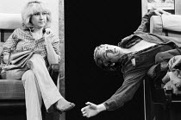
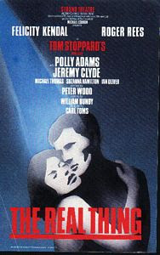
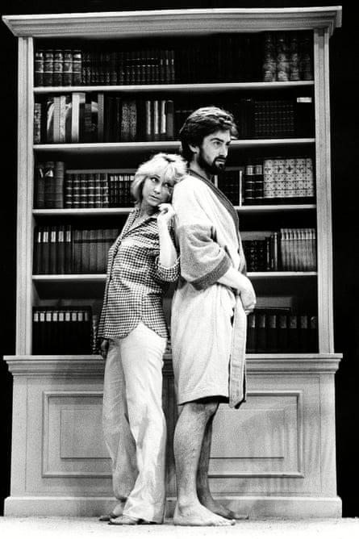
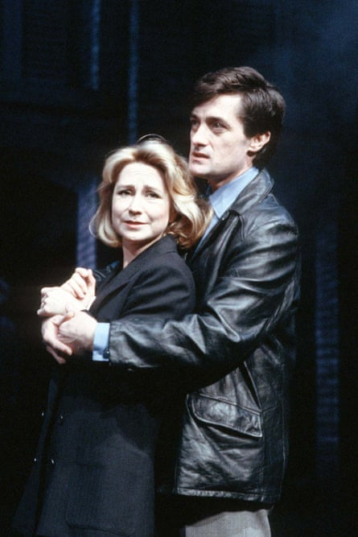
And the ending?

