Slide 1
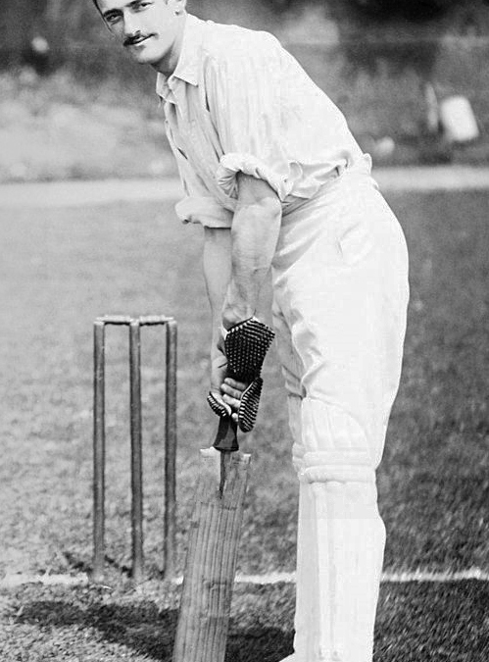
'THOUGHT AND CALCULATION': EXAMINING THE THEATRICAL INVENTION OF TOM STOPPARD IN 3 PLAYS
SESSION 1 —The Field of Play

Slide 2
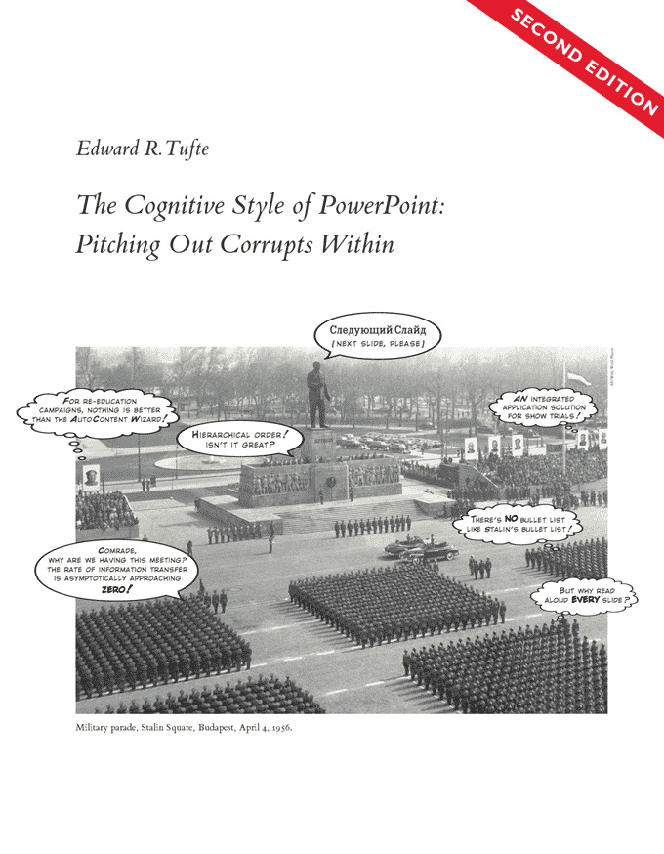
Yes, I Use PowerPoint!
But NOT FOR LAUNCHING SPACESHIPS OR RUNNING POLITICAL CAMPAIGNS

Slide 3

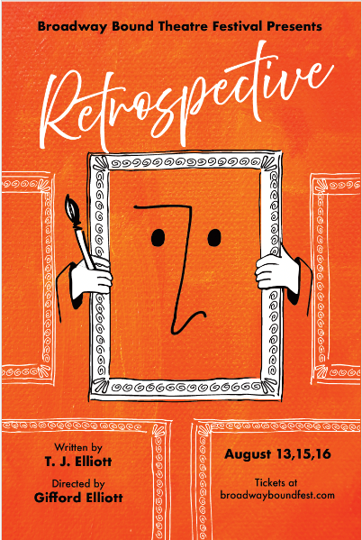
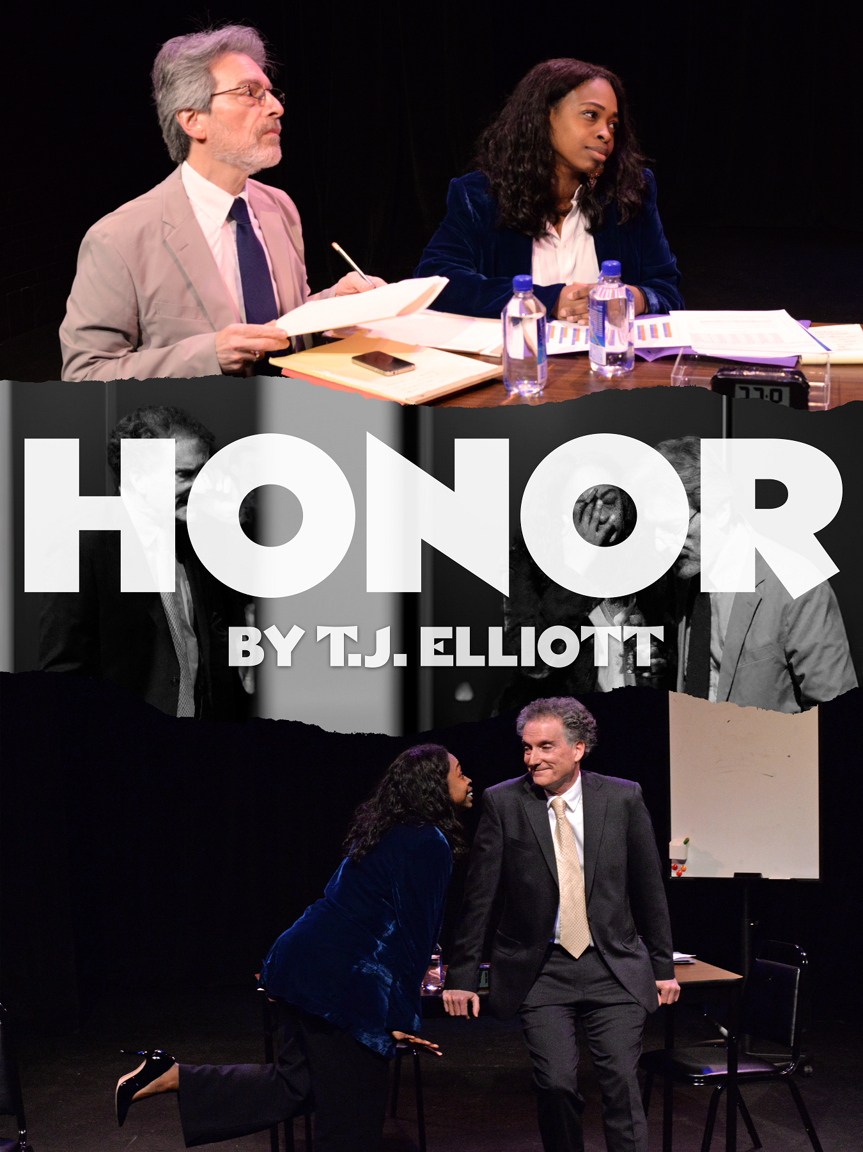
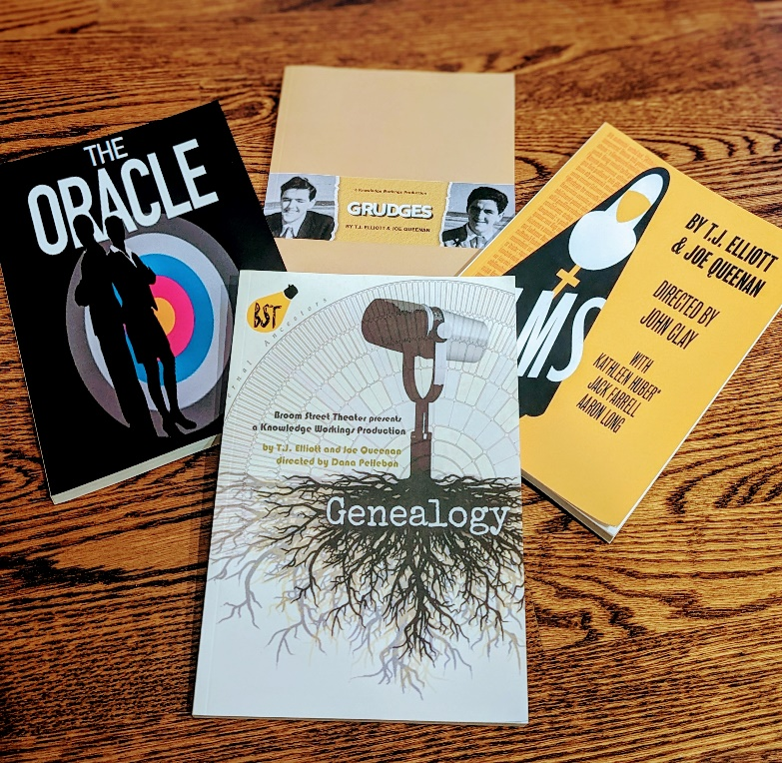
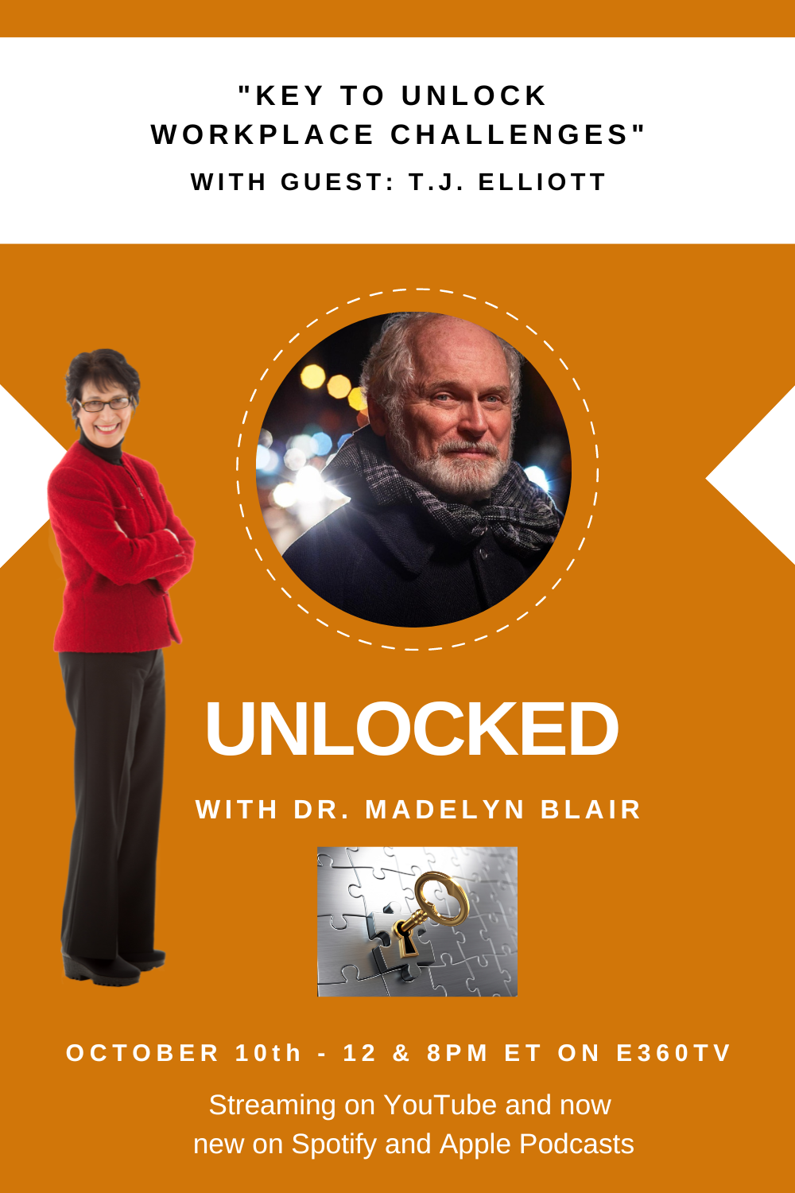
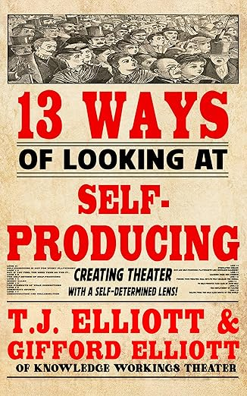
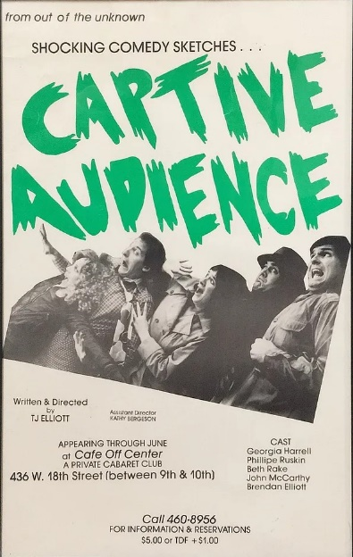
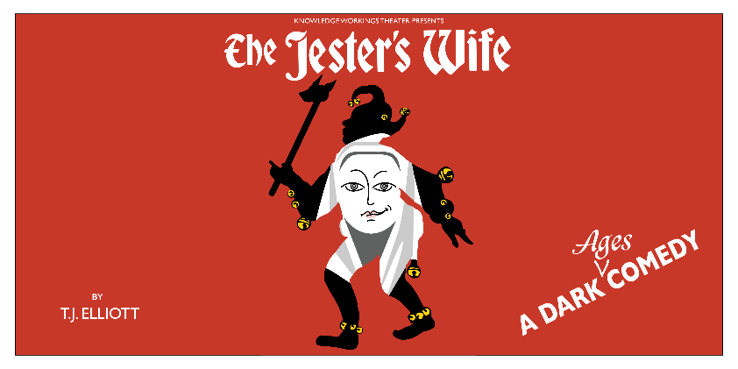
Not an academic authority: More a fan, practitioner, and explorer
2025
1981-2

Slide 4

And What Brings You Here?
“It’s wanting to know that makes us matter. Otherwise, we’re going out the way we came in.”
Hannah Jarvis in Tom Stoppard's Arcadia

Slide 5

What brings us here?
What will make this five week experience a success for you?
Is there a specific interest that you would like emphasized about playwrighting? Stoppard? Art? Life?
Hermione Lee wrote that Stoppard returns repeatedly to "questions of morality, ethics, political beliefs, and personal liberty." In these 3 plays, divorce, infidelity, teenage adoption, data fraud, and a tragic death by fire occur. Any concerns?
Do we have willing readers for some scenes?

Slide 6
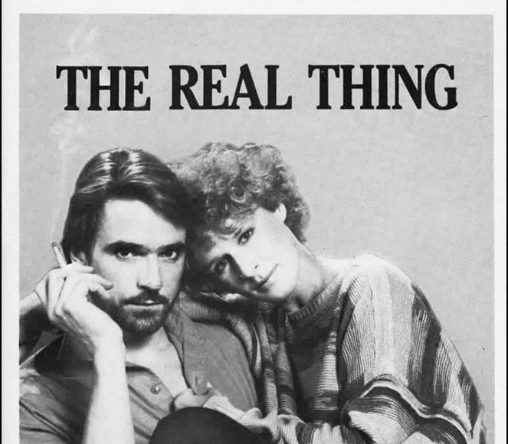
How Is Your Play Reading Going?
If it’s going at all

Slide 7
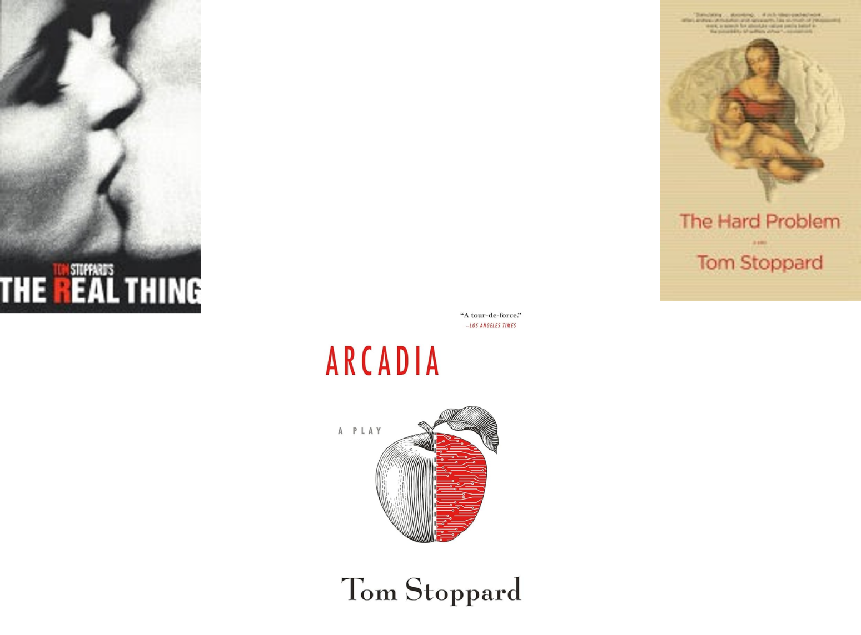
An Outline of Our Sessions
Session 1: The Field of Play
Session 2: The Real Thing
Session 3: Arcadia
Session 4: The Hard Problem
Session 5: Colliding Ideas & Concluding Insights

Slide 8

A General Scheme for Sessions 2-5
Shedding some light
What’s going on here in this play? Or for Session 5, these plays
What thoughts — ideas, calculations, themes — did you perceive as part of the play TS constructed?
Where would TS 'have us stand? Or with whom?
Irony anyone? Contradictions?
How would you characterize your post-reading or viewing experience?
Did you have questions afterwards?
Navigating some themes and devices
Use a few scenes to flesh out examples of these thoughts and calculations of TS; NOTE: that ‘looking’ will happen by watching some videos of scenes or volunteers reading them in class. I emphasize that only volunteers will read; no one will read who does not wish to do so.

Slide 9
Angles of View; Devices of Construction
to know (all) the angles: to have a comprehensive knowledge of something; to understand the subtleties
Craft
Dramatic Irony
Play within a Play
Comical Confusion
Analogies and Allusions
Foreshadowing & Foregrounding
Callbacks and Effective Repetition
Paradox
Freedom and Morality
Order and Chaos; Mathematics
Conservatism; Rejection of Relativism

Slide 10
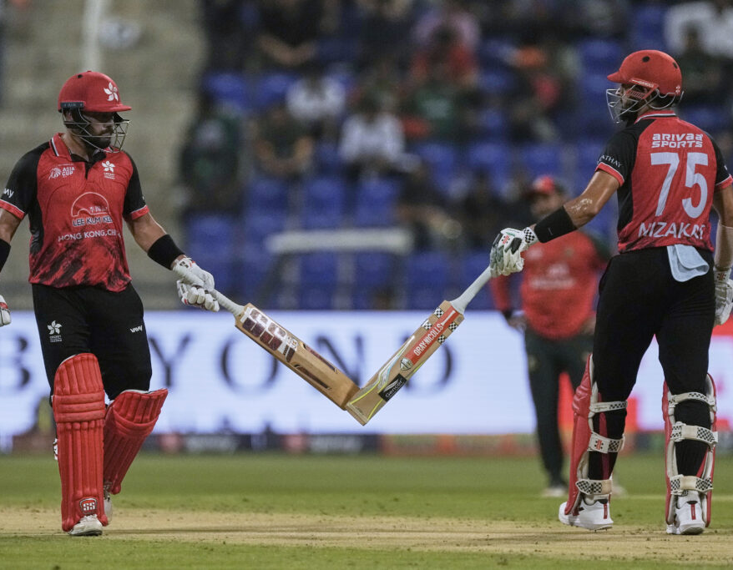
Today: The Field of Play
Tom Stoppard’s life in 5
Some major preoccupations
Words: That Cricket BAT!
Thoughts and calculations
Yoking of ideas
Game within a game
Antipathy for amateurs
Uncertain about certainty
Playwrighting
Building materials
Actors on Stoppard
Some interview snippets

Slide 11
Major Original Works
1982: The Real Thing *
1988: Hapgood
1993: Arcadia *
1997: The Invention of Love
1997: The Seagull – a translation of the play by Anton Chekhov
2002: The Coast of Utopia – a trilogy of plays: Voyage, Shipwreck, and Salvage
2006: Rock 'n' Roll – First public performance 3 June 2006 preview at the Royal Court Theatre.
2015: The Hard Problem *
2020: Leopoldstadt
1966: Rosencrantz and Guildenstern Are Dead
1968: Enter a Free Man
1968: The Real Inspector Hound
1970: After Magritte
1972: Jumpers
1972: Artist Descending a Staircase
1974: Travesties
1976: Dirty Linen and New-Found-Land
1977: Every Good Boy Deserves Favour
1978: Night and Day
1979: Dogg's Hamlet, Cahoot's Macbeth

Slide 12
Adjectival Stoppard
Biographer Hermione Lee asked some of Stoppard’s friends for adjectives to describe TS:
"I’ve often asked people to sum him with three words. They come up with 'polymathic, brainy, inspirational, passionate, rigorous, sympathetic, conservative with a small c, irresistible, supportive, witty, curious, open, gentle, thoughtful, amatory, daunting, clear- thinking, focused, stimulating, brave, warmhearted…by far the most frequent adjectives have been loyal, kind, considerate, glamorous, generous, and intelligent… Nobody says cruel, proud, selfish, or inattentive.'”
More from biographer Lee and (indirectly) from Stoppard himself:
"He has often said that he is a playwright in search of a plot and that when the idea for a play springs at him : “it’s as though at the far end of this gilded hall, the double doors have opened and a butler bearing a siver tray turns up and slowly approaches with the idea.. which he just puts in front me while the trumpets sound."

Slide 13
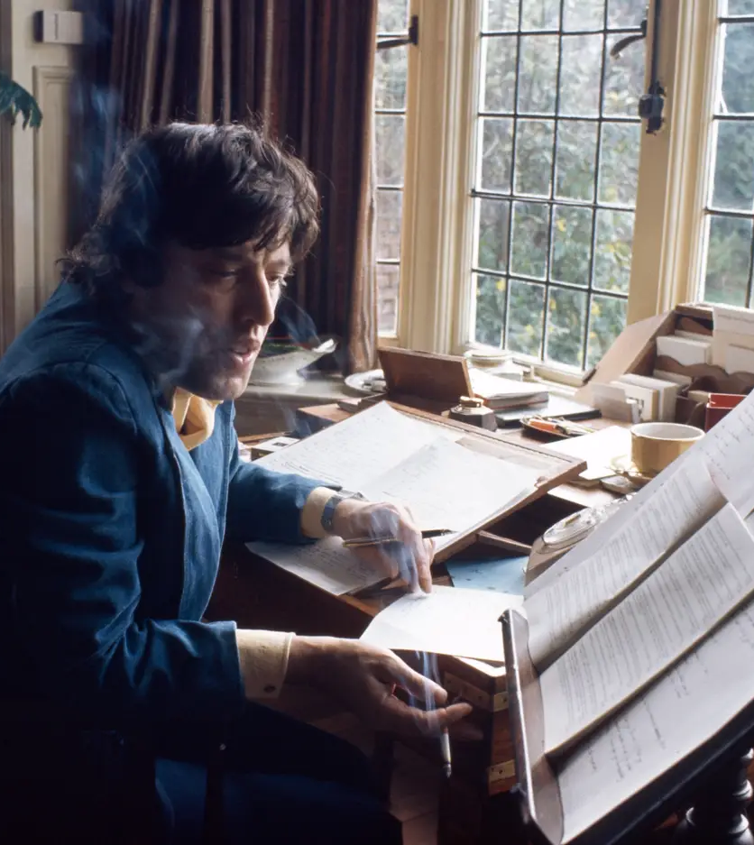
Biographical Fallacy? Or Analogy?
His 1st wife Jose - from whom he was to separate three years later: "The hardest thing I've had to accept is that if I died or disappeared he'd be upset, but in the end his life wouldn't be all that different. Writing is the core of his existence.“
The Real Thing, dedicated to 2nd wife, Miriam, has lots of allusions to things that went on with Jose, but foreshadows how his 2nd marriage breaks up via an affair with an actress in one of the lead character’s plays, which is what happened with Felicity Kendal.
"We always assumed The Real Thing had a lot to do with Tom's marriage. You wouldn't get Tom to say that, but I think it is pretty autobiographical. Henry the writer, who is very clever but can't actually cope with family life.“ Kenneth Ewing, Stoppard's agent for 40 years
"Tom's a writer who reveals himself in everything he writes.“ Richard Eyre, who directed The Invention of Love in 1997

Slide 14
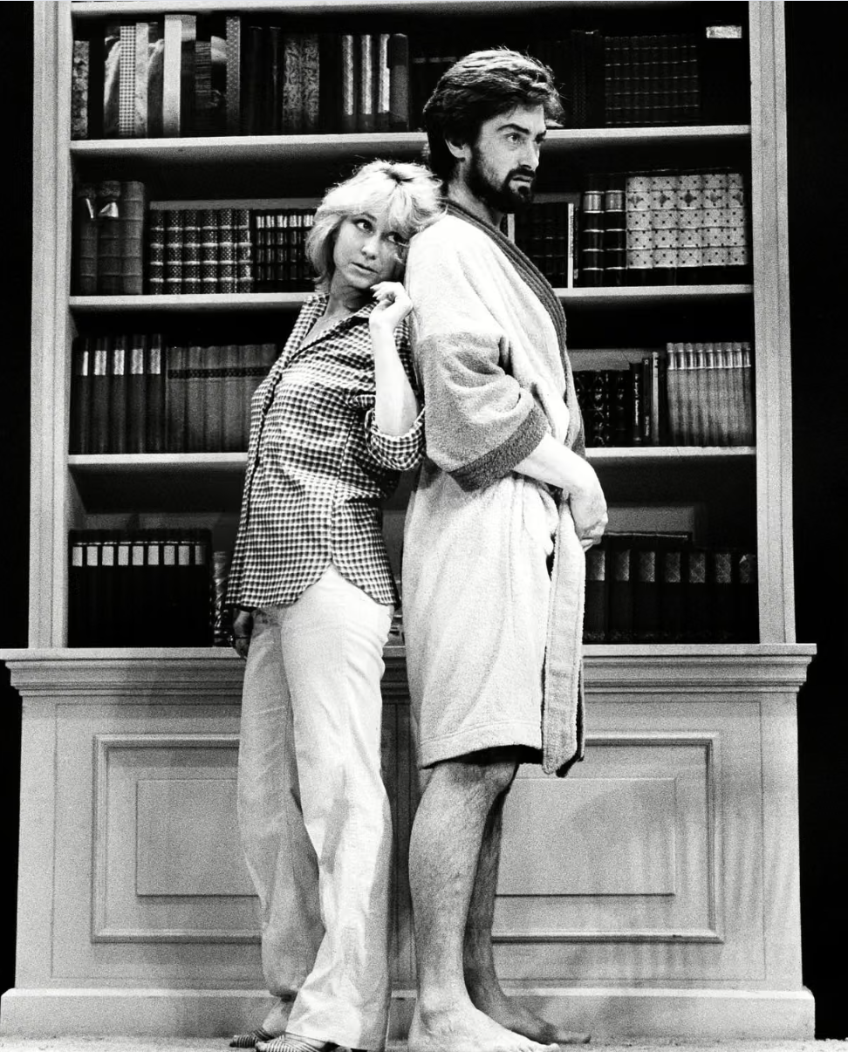
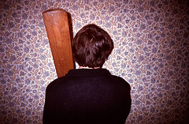
“The whole difficulty of doing plays — the reason one doesn’t do two or three a year — is this very thing of trying to subsume thought and calculation into the interior of, say, a love story or a story of triumph and failure.” Tom Stoppard
“The choice of words in the right order is what I do.”

Slide 15
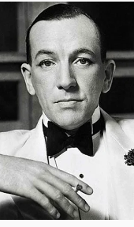
Thoughts and calculation begin — and end —with Ideas in Stoppard
“The most important ingredients for a play: life, death, food, sex, and money — but not necessarily in that order.” Noel Coward
"In a 45-year career spanning stage, screen and radio, (Stoppard ) is credited with bringing ideas back into British theatre. With Rosencrantz and Guildenstern Are Dead (1966)… he became the youngest playwright to be staged by the National and spawned a sub-genre of bit-players placed centre-stage.”
“Stoppardian" has become a trademark, not least for rapid-fire wit and bathetic juxtaposition, whether moral philosophy with gymnastics, as in Jumpers (1972), or the collision of Lenin, Joyce and Tristan Tzara with Wildean pastiche in Travesties (1974).” Maya Jaggi, The Guardian, 2008
“the most widespread misapprehension about playwrights... is that they set out to say something and then say it, in short that a play is the end product of an idea.” "But I must make clear that, insofar as it's possible for me to look at my own work objectively at all, the element which I find most valuable is the one that other people are put off by – that is, that there is often no single, clear statement in my plays"

Slide 16
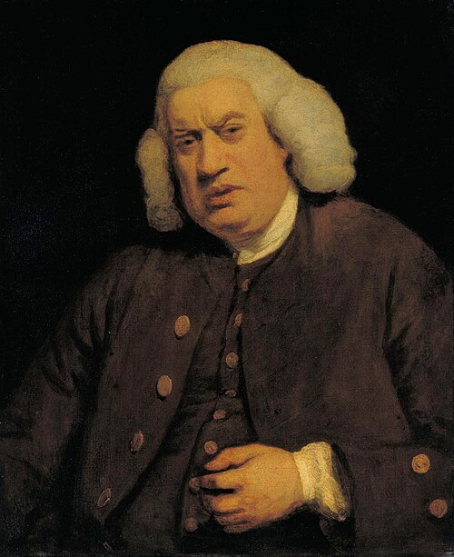
YET...
Stoppard also once said, “The whole thing derives from a misapprehension about creative writing, which is that the writer is working from a set of principles or a thesis and the play is the end product of that predisposition, but, actually, the idea turns out to be the end product of the play, and the less I know about this play I am ­trying to write, the better.”
Yes, but that idea at the end of a play is the result of what we will later see TS admit after Samuel Johnson to his ‘violent yoking’ of OTHER ideas or as in Arcadia a stirring of ideas together as in Thomasina’s question about the porridge and strawberry jam.
“Stoppard’s greatest source of abundance is, above all, the volume and variety of ideas. What he has described as ‘a fairly complicated intellectual argument’ characterises plays which encompass the science of Chaos and Newtonian theory in Arcadia, the physics of Einstein and Heisenberg’s quantum mechanics in Hapgood and David Chalmers’ theory of consciousness in The Hard Problem. Jumpers and Darkside explore the source of moral values to which The Hard Problem attempts to apply the concept of value.” Nigel Purse
"The most heterogeneous ideas are yoked by violence together; nature and art are ransacked for illustrations, comparisons, and allusions; their learning instructs, and their subtilty surprises; but the reader commonly thinks his improvement dearly bought, and, though he sometimes admires, is seldom pleased."

Slide 17
BUT...
What is Stoppard admitting or disputing with his allusion to Dr. Johnson's quote, his confession that in the end his plays are the result of this ‘violent yoking’ of OTHER ideas
After all, Johnson in employing the metaphor is criticizing the Metaphysical poets like John Donne:
"The most heterogeneous ideas are yoked by violence together; nature and art are ransacked for illustrations,comparisons, and allusions; their learning instructs, and their subtilty (sic) surprises; but the reader commonly thinks his improvement dearly bought, and, though he sometimes admires, is seldom pleased."
Is Stoppard again having that argument with himself?
Is he reveling in being like those metaphysical poets?
Is he meeting the criticism of him as too intellectual?
This dialectical approach – cross-examining and, if necessary, refuting himself – will come up in all three of our plays.

Slide 18
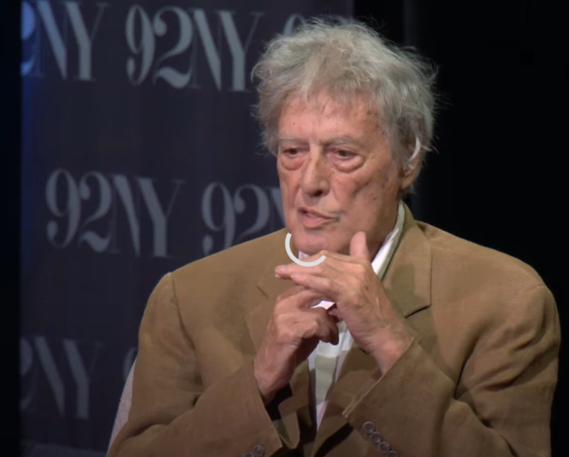
“extraordinary how much of the procedure is actually unconscious”
https://youtu.be/FAJLBDCCTg8?si=4hTy3YABmcQSCwz0&t=1275
21:15 to 26:25

Slide 19

"...SUBSUME THOUGHT AND CALCULATION INTO THE INTERIOR OF, SAY, A LOVE STORY OR A STORY OF TRIUMPH AND FAILURE.”
"To say that Stoppard is interested in ideas, and in their incarnation through bodies and in their expression through artful talk, is really only to say that he is interested in drama itself. That’s the job: grabbing the abstract out of the clouds and giving it flesh. The test … is whether the writer can tether thought to emotion, theory to the practice that is life.” Vinson Cunningham in The New Yorker
Notes:
”I am not a mathematician, but I was aware that for centuries mathematics was considered the queen of the sciences because it claimed certainty. It was grounded on some fundamental certainties—axioms—that led to others. But then, in a sense, it all started going wrong, with concepts like non-euclidean geometry—I mean, looking at it from Euclid’s point of view. The mathematics of physics turned out to be grounded on uncertainties, on probability and chance. And if you’re me, you think—there’s a play in that. Finding an idea for a play is like picking up a shell on a beach. I started reading about mathematics without finding what I was looking for. In the end I realized that what I was after was something that any first-year physics student is familiar with, namely quantum mechanics.”

Slide 20
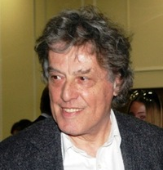
Morality & Order
“However inflexible our . . . beliefs . . . they owe their existence to individual acts between individuals, which themselves are derived from an individual’s intuitive sense of what is right and wrong.”
“All political acts have a moral basis to them and are meaningless without it.”
“Morality makes no difference legally.”
“I’m the kind of person who embarks on an endless leapfrog down the great moral issues. I put a position, rebut it, refute the rebuttal and rebut the refutation. Endlessly.”
— Tom Stoppard

Slide 21
Math Whiz
“Mathematics represents a conspicuous through-line in Tom Stoppard's body of work. The allusions to the Riemann hypothesis in the recently produced Leopoldstadt (2020) form a notable bookend with the musings on probability in Rosencrantz & Guildenstern Are Dead (1966) that launched Stoppard's career. In the intervening decades, the playwright's ongoing self-education in mathematics surfaces in a series of cleverly staged debates about providence versus free will, the existence of moral absolutes, and the origins of human consciousness. Contrary to expectations, the mathematics in these plays most often serves as a catalyst for the persistence of uncertainty in a rising tide of rationalism. The decision to place a pure mathematician at the centre of Leopoldstadt, an autobiographically-inspired family epic about the Holocaust, reveals the depth of Stoppard's fondness for mathematics and his faith in its potential to tell human stories. As it has in earlier plays, the mathematics in Leopoldstadt offers a distinctive commentary about the tension between rational order and randomness while also making a quiet case for the perseverance of beauty in the darkest of possible worlds.”
Stephen Abbot, The Mathematical Heart of Tom Stoppard
Notes:
The Mathematical Heart of Tom Stoppard
Stephen Abbott
Modern Drama
University of Toronto Press
Volume 67, Number 1, March 2024
Riemann hypothesis
Article
Talk
Read
Edit
View history
Tools
Appearance
hide
Text
Small
Standard
Large
Width
Standard
Wide
Color (beta)
Automatic
Light
Dark
From Wikipedia, the free encyclopedia
For the musical term, see Riemannian theory.
Unsolved problem in mathematics
Do all non-trivial zeros of the Riemann zeta function have a real part equal to one half?
More unsolved problems in mathematics
This plot of Riemann's zeta (ζ) function (here with argument z) shows trivial zeros where ζ(z) = 0, a pole where ζ(z) = ∞, the critical line of nontrivial zeros with Re(z) = 1/2 and slopes of absolute values.In mathematics, the Riemann hypothesis is the conjecture that the Riemann zeta function has its zeros only at the negative even integers and complex numbers with real part ⁠1/2⁠. Many consider it to be the most important unsolved problem in pure mathematics.^{[1]} It is of great interest in number theory because it implies results about the distribution of prime numbers. It was proposed by Bernhard Riemann (1859), after whom it is named.
The Riemann hypothesis and some of its generalizations, along with Goldbach's conjecture and the twin prime conjecture, make up Hilbert's eighth problem in David Hilbert's list of twenty-three unsolved problems; it is also one of the Millennium Prize Problems of the Clay Mathematics Institute, which offers US$1 million for a solution to any of them. The name is also used for some closely related analogues, such as the Riemann hypothesis for curves over finite fields.

Slide 22
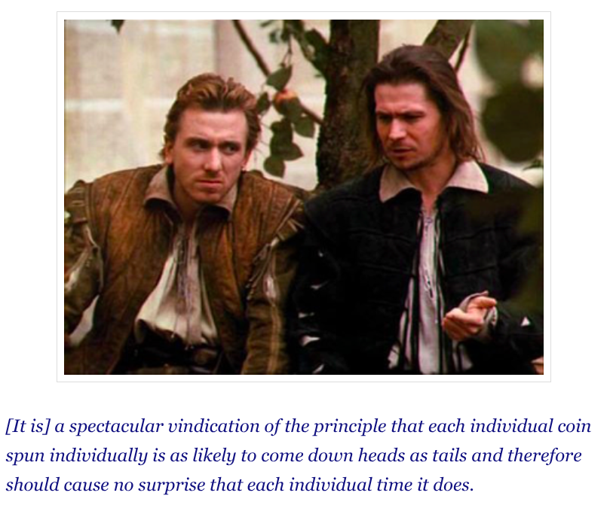
a game within a game
"For Stoppard, art is a game within a game, the larger game being life itself, an absurd mosaic of incidents and accidents in which (as Beckett, whom he venerates, says in the aptly titled Endgame) 'something is taking its course'. We cannot know what that something is, or whither it is leading us; and it is therefore impermissible for art, a mere derivative of life, to claim anything as presumptuous as a moral purpose or a social function.“ Kenneth Tynan New Yorker profile in 1977
OR TO CLAIM CERTAINTY
The Coin-Flippjng Scene

Slide 23
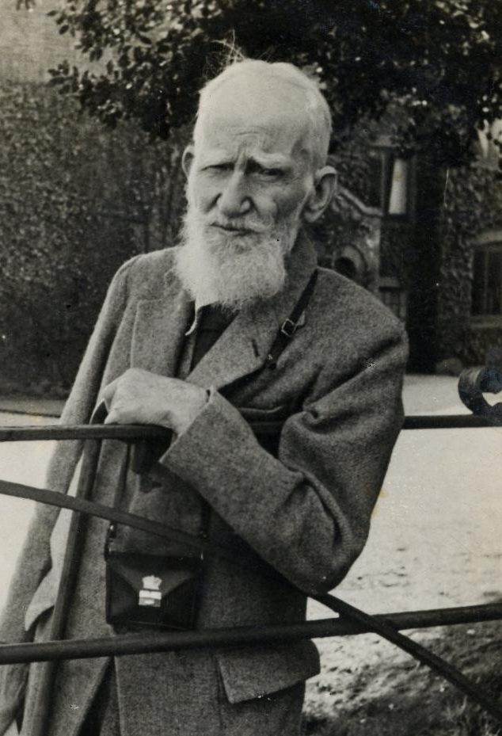
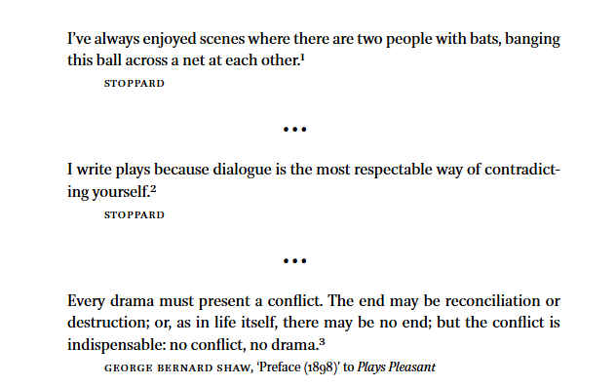
Conflict

Slide 24
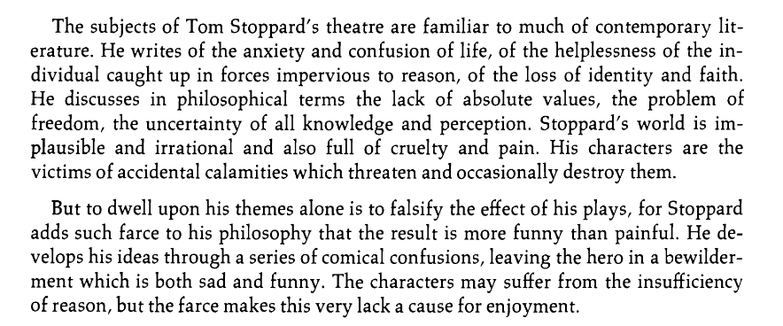
Comical Confusion for Characters AND Audience

Slide 25
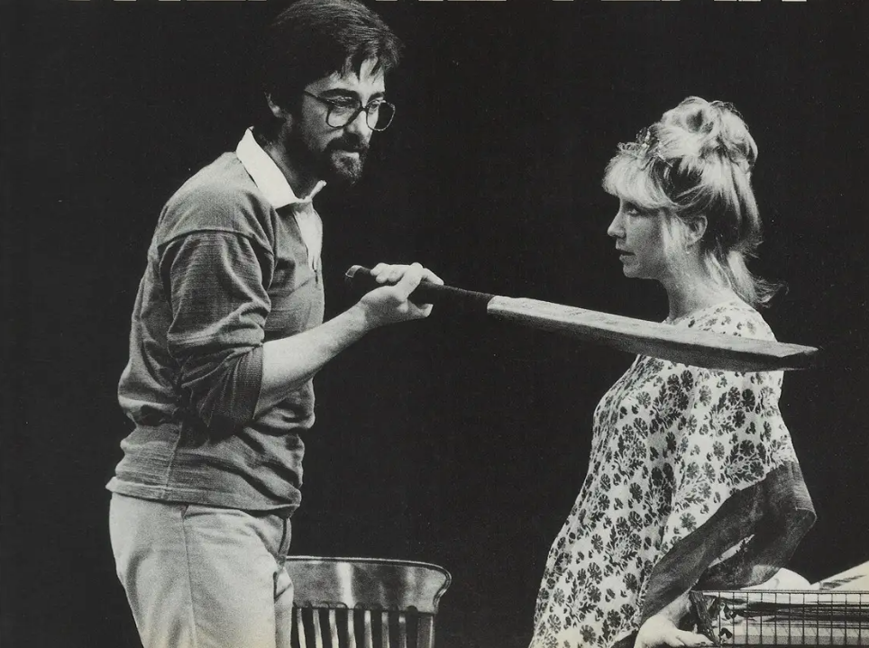
An Antipathy to Amateurs
Brodie in The Real Thing
Chater in Arcadia
Amal in The Hard Problem

Slide 26
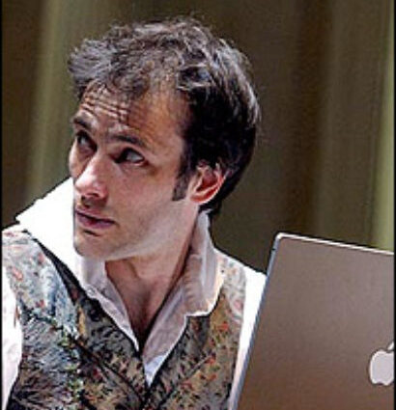

"Theater is not about understanding, it’s about connecting — it’s about emotions”
Ed Stoppard in talking about what it was like for him to play in Arcadia noted what’s really going on in the speech when the character Valentine is explaining chaos theory: “if you went: ‘so this is a speech about chaos, fractals, acts, questions and scale,’ you think, you’re kidding me. But on the few occasions I got it right you could hear a pin drop… What the audience isn’t doing is understanding chaos theory. What they are doing is feeling for a moment the emotions it arouses in a person who does understand it… Audiences leave feeling… They’ve connected emotionally. Theater is not about understanding, it’s about connecting — it’s about emotions”

Slide 27
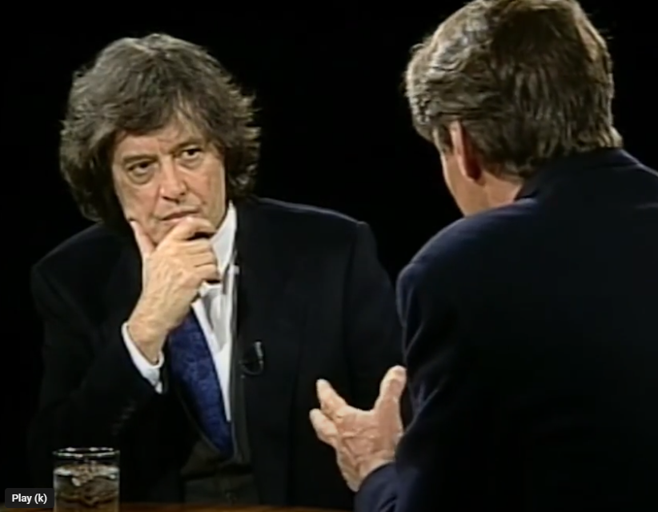
Theater is a storytelling art form
https://youtu.be/EEmK_Tumgr4?si=FXdopFHj0-lHEjc7&t=88
1:28 – 4:24

Slide 28
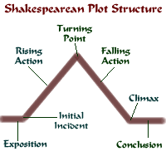
Play A dramatic or theatrical performance staged before an audience Wright An artificer or handicraftsman; a constructor
Ben Jonson seemingly is the first to join the words ‘play’ and ‘wright’ together to indicate a builder of theatrical performances

Slide 29
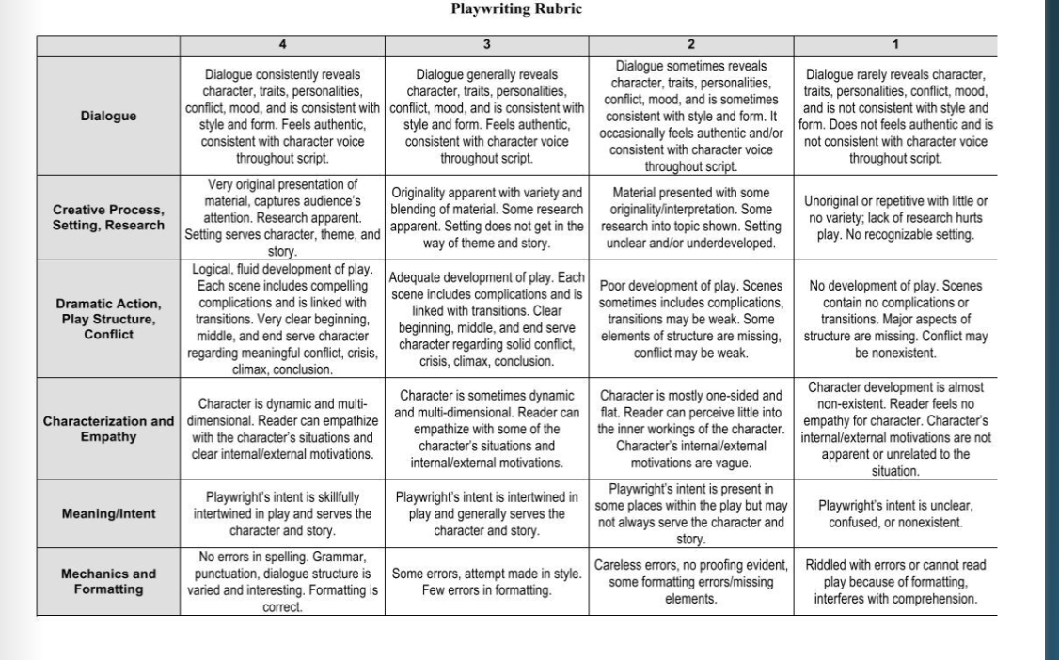
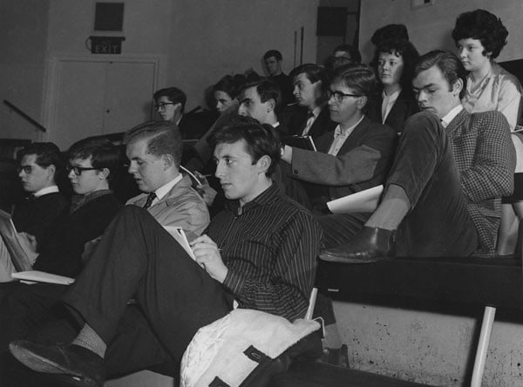
There Is No Rubric Despite What Schools Might Teach

Slide 30
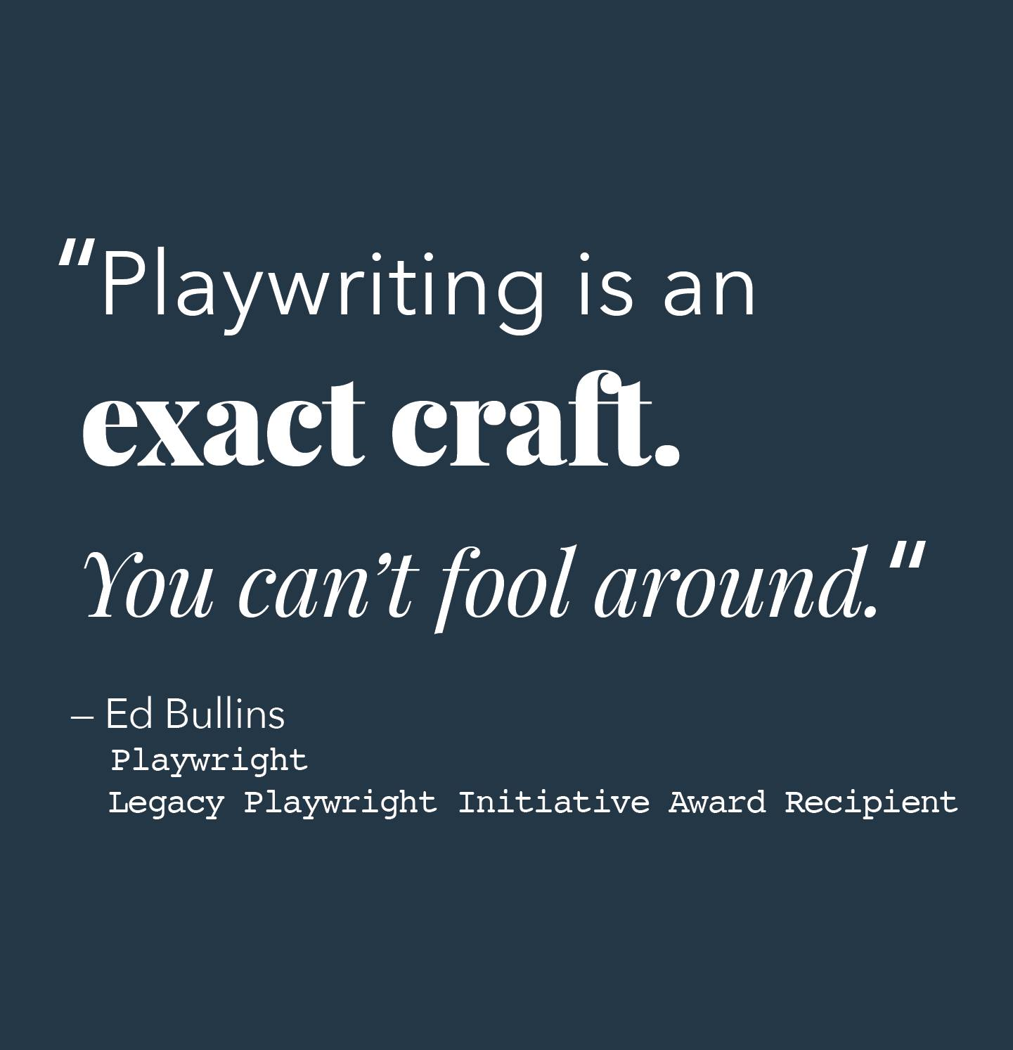
A craft in which tools are borrowed, adapted, and invented: what tools does Stoppard use?
Play within a Play
Analogies and Allusions
Foreshadowing
Foregrounding
Dramatic irony
Callbacks and Effective Repetition
Paradox
Notes:
The use of unorthodox or unexpected devices in language.
Stressed as ˈforegrounding.
1959
The Prague School notion of what has been translated as ‘foregrounding’..is defined by Mukařovský as ‘the aesthetically intentional distortion of the linguistic components’ in relation to the normal standard language on the one hand and to ‘the traditional aesthetic canon’ on the other.
R. Quirk in Quirk & Smith, Teaching of English i. 45
1964
Automatization refers to the stimulus normally expected in a social situation; foregrounding—in Czech aktualisace—on the other hand refers to a stimulus not culturally expected in a social situation and hence capable of provoking special attention.
P. L. Garvin, Prague School Reader p. viii

Slide 31
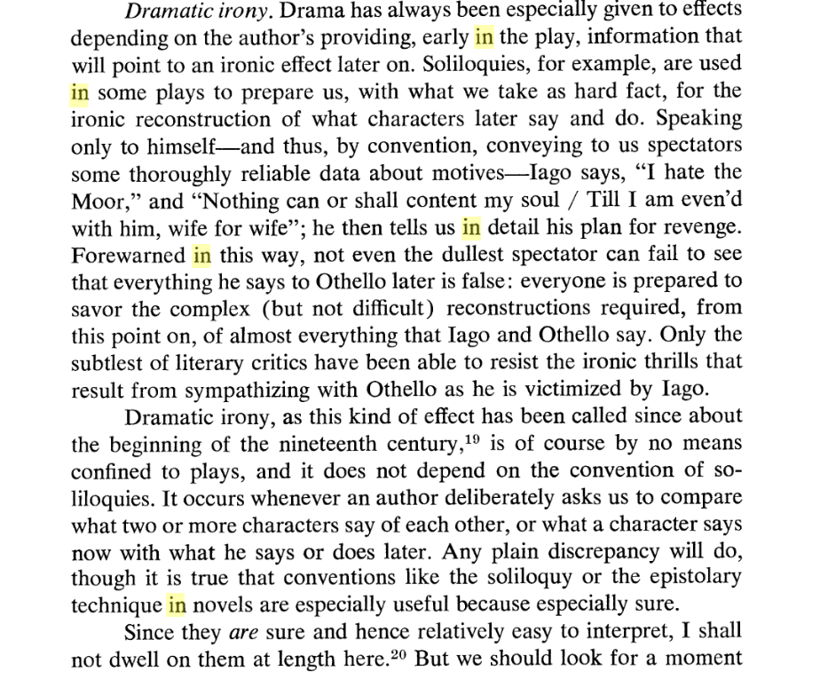
Dramatic Irony: Something Amiss
Our human sympathies And antipathies are worked on with each detail that seems amiss, to play upon our expectations keeps us engaged

Slide 32
Order and Chaos
"An abiding concern is his sometimes comic exploration of the relationship between order and chaos and the possible unreliability
of conventional scientific truths. His plays themselves are often constructed out of seemingly bizarre concatenations of events. There is an order out there, but it often has to be imagined,
and although he is conservative about science, as in everything else he is very much aware of the inadequacy of simple linear theories.“
Norman Barry
Notes:
Norman Barry
https://fee.org/articles/freedom-and-morality-in-the-plays-of-tom-stoppard/#:~:text=An%20abiding%20concern,simple%20linear%20theories.

Slide 33
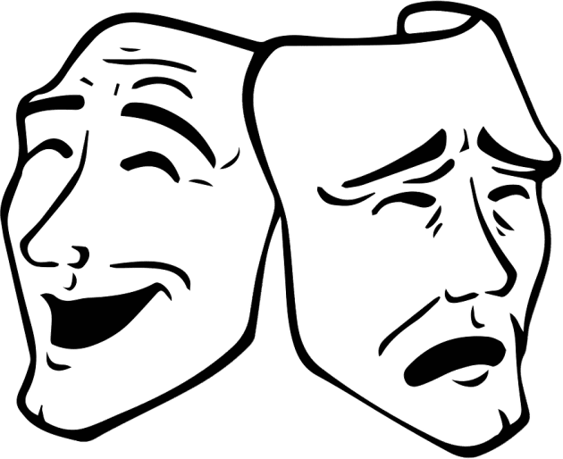
Building Materials
Themes
Characters
“It must be that the character could do no other as we have seen her journey and change by what happened and was said within the story …Character is the most interesting phenomenon anywhere. Every character represents a world of his own, and the more you know of this person the more interested you become.“ —Lajos Ecri
Dialogue
‘Dialogue is the most respectable way of contradicting myself’ — TS
"Adversarial collaborations might reduce interpersonal conflict by turning adversaries into sparring partners who improve one another’s science."
Notes:
Taboos and Self-Censorship Among U.S. Psychology Professors, CoryJ. Clark Matias Fjeldmark, Philip E. Tetlock et al

Slide 34
Building Materials
Targets the PLAYWRIGHT sets
“For the actor, all ‘doing’ has to be done to something. The actor can do nothing without the target.”
Movement
The power of a performer’s movement is the result of ‘synthesis’, of the concentration, into a small space, of an action which uses a large amount of energy and reproduces only those elements essential to the action, any accessory elements being eliminated.” — Dario Fo
Spatial/ Temporal Fields
Visuals: Set, Costume, Lighting, Effects
Magic
“That’s the thing about later. You don’t know what’s coming up. You don’t know how all the loose ends are going to gather together. Something for sure is going to happen but you don’t know what it is.” — Sam Shepard
Notes:
Actors are told where to stand, what objects to pick up, what to hear
Scenes may conflate, exist side by side, or be sequential. Time can pass quickly or seem not to exist at all

Slide 35
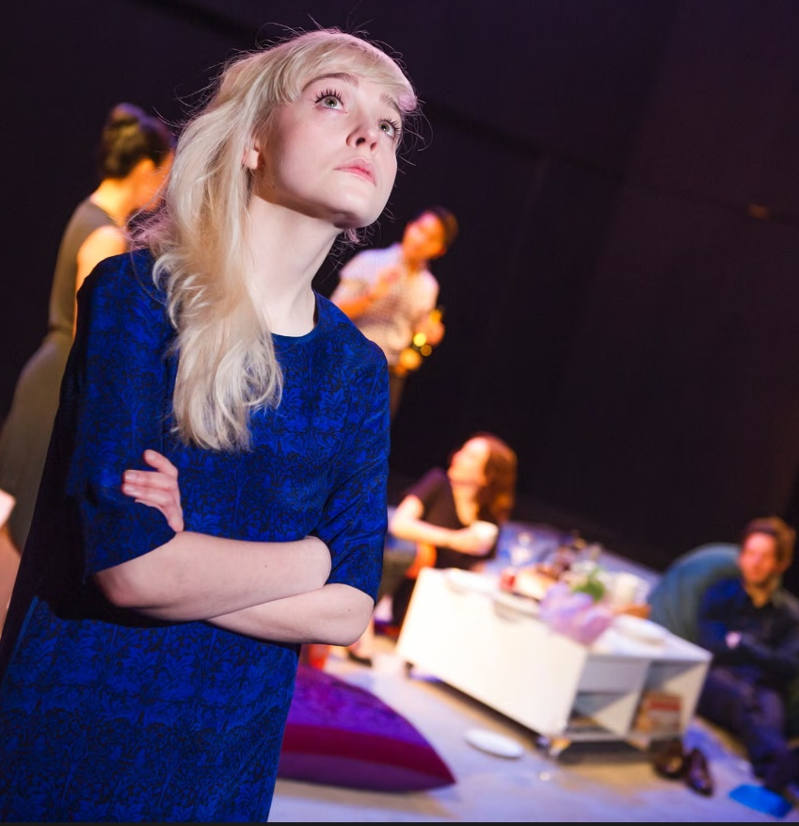
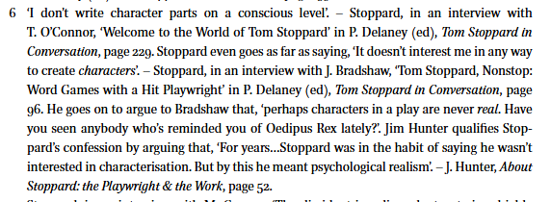
Methinks Tom Doth Protest Too Much Sometimes
Characters?

Slide 36
Conflict
Stoppard sees his plays as a “series of conflicting statements made by conflicting characters, and they tend to play a sort of infinite leap-frog. You know, an arguments, refutation, then a rebuttal of the refutation, then a counter-rebuttal, so that there is never any point in this intellectual leap-frog at which I feel that is the speech to stop it on, that is the last word.”

Slide 37

Stoppard and Intertextuality
Intertextuality—or the way in which texts gain meaning through referencing other written work—is a recurring concept in the Stoppard canon; his plays Rosencrantz and Guildenstern Are Dead and Travesties reference and re-contextualize the work of others (Shakespeare, Albee, T.S Eliot, Beckett, et al.), to create a new, richly layered work. As scholar Kinmerth Meyer notes, Stoppard’s intertextual flourishes are used not to show off his gamesmanship (as some have claimed) but to “reaffirm the validity of literature in the human experience,” allowing Stoppard to "frame deeply personal considerations of human action, its motives and limitations and values," especially among characters who are playwrights and actors themselves.
—Lauren Halvorsen
Notes:
Tom Stoppard explores the nature of illusion in The RealThing: What constitutes reality in love, art, and politics? The Real Thing originated as a structural challenge for Stoppard: “This play wasn’t written in order to say certain things about writing,” he says. “It was written because Iliked the idea of the game, the device of having the same thing happen two or three times.” In constructing thisgame, Stoppard references other works to both challenge narrative perception and use literature as a method forunderstanding one’s own experience.
Excerpts from August Strindberg’s Miss Julie and JohnFord’s ‘Tis Pity She’s a Whore figure prominently in TheReal Thing. The play’s other literary tributes range fromobscure to obvious—Stoppard borrows plot devices andparaphrases dialogue from Shakespeare, John Osborne,Noel Coward, George Gershwin, and Oscar Wilde, to namea few.

Slide 38
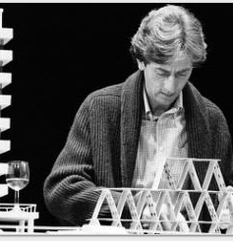
Words Matter; Dialogue Drives Effects
“Words... They're innocent, neutral, precise, standing for this, describing that, meaning the other, so if you look after them you can build bridges across incomprehension and chaos. But when they get their corners knocked off, they're no good any more... I don't think writers are sacred, but words are. They deserve respect. If you get the right ones in the right order, you can nudge the world a little or make a poem which children will speak for you when you're dead.”
― Tom Stoppard, The Real Thing
Dialogue: “A literary work in the form of a conversation between two or more persons, in which opposing or contrasting views are imputed to the participants.”
Dating from 593 AD and Pope Gregory’s Dialogues

Slide 39
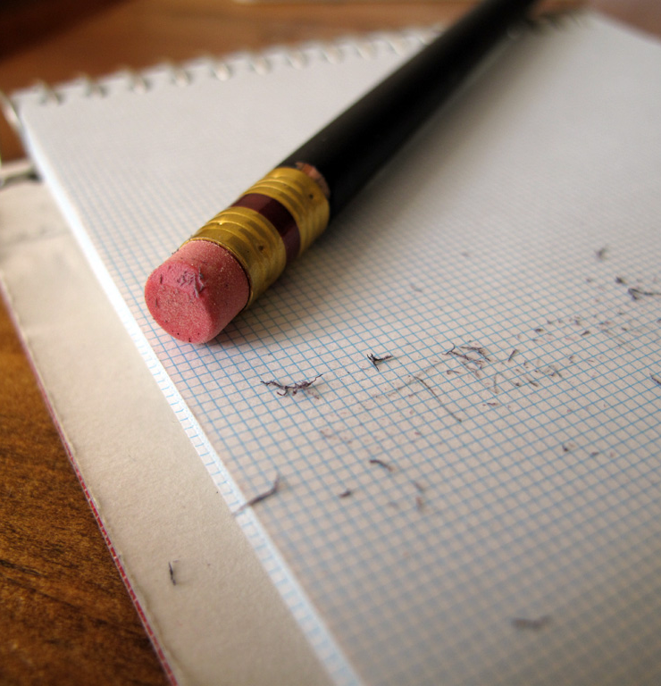
Writing Is Rewriting and Theatre Is An Event Created On The Fly
INTERVIEWER
How are the rehearsals going?
TOM STOPPARD
So far they are conforming to pattern, alas! I mean I am suffering from the usual delusion that the play was ready before we went into production. It happens every time. I give my publisher the finished text of the play so that it can be published not too long after the opening in London, but by the time the galleys arrive they’re hopelessly out-of-date because of all the changes I’ve made during rehearsals. This time I gave them Hapgood and told them that it was folly to pretend it would be unaltered, but I added, “I think it won’t be as bad as the others.” It turned out to be worse. Yesterday I realized that a chunk of information in the third scene ought to be in the second scene, and it’s like pulling out entrails: as in any surgery there’s blood. ... So the answer to your question is that the rehearsals are going well and enjoyably, but that I’m very busy with my pencil.
This Photo by Unknown Author is licensed under CC BY-NC

Slide 40
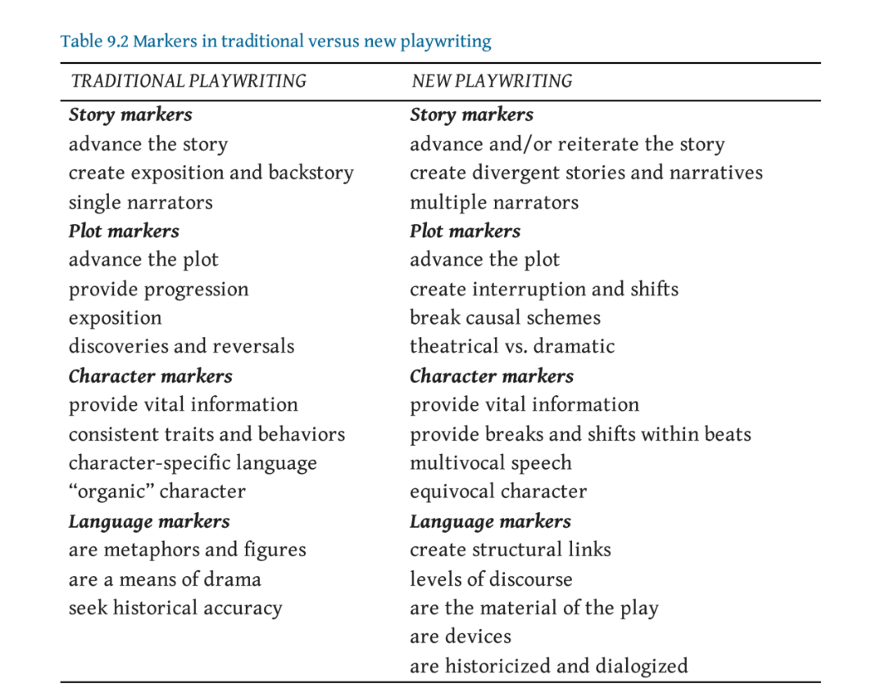
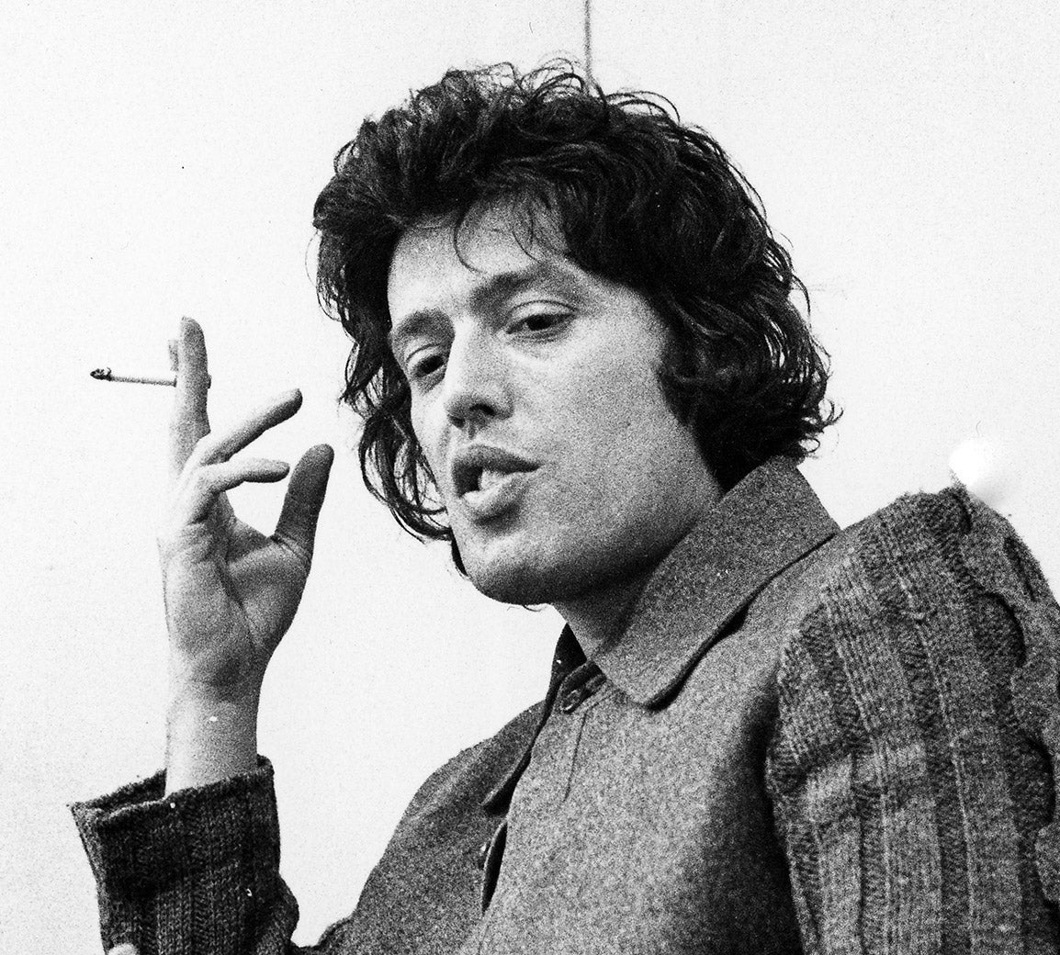
Is Stoppard New or Trad?

Slide 41
Actors on Stoppard
"As an actor, the only playwright to present challenges comparable to Shakespeare is Stoppard. People complain that Shakespeare is going to be too difficult to understand. Our job is to take those worries away and to somehow communicate meaning. It's the same with Stoppard."
Anthony Sher
"What's wonderful about working with Tom Stoppard is that he’s so curious and excited about life and making entertainment for people that is in the service of something. He fully explores the art form and what it can do“
Ethan Hawke
“The work of Tom Stoppard doesn’t presume to find the unity, the meaning, the key to all the mythologies of our lives. Tom doesn’t seek to rearrange the world, instead he rearranges us.”
Glenn Close
”So we had Tom Stoppard in the room, giving us a tutorial almost for 5 hours for 2 or 3 consecutive days about all the ideas and the relationships and why he chose one word and what he thinks works here. So, had he been anyone else, but the brilliant and entertaining Tom Stoppard I would have been bored to death listening to anybody talk for 5 hours. But he’s a genius and he’s a genius that likes to show off, but it was wonderful. An enormous resource.”
Margaret Colin

Slide 42
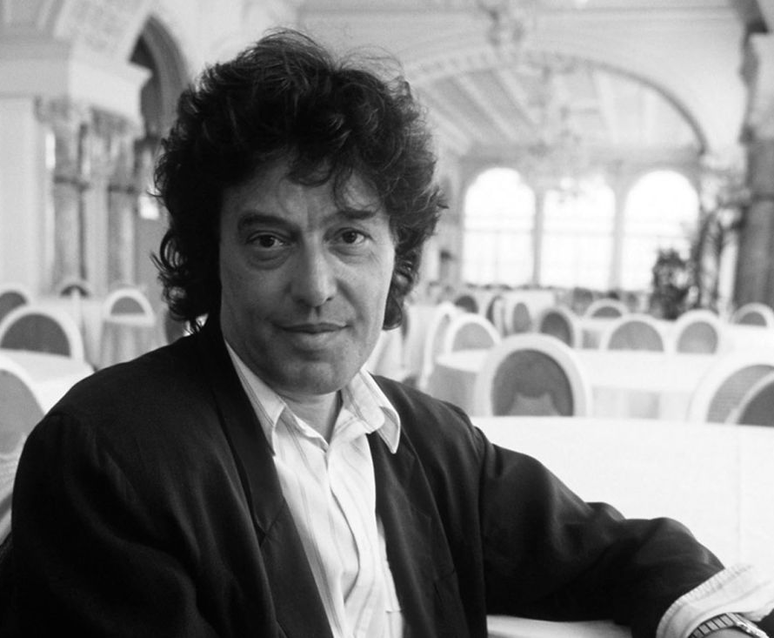
Some other video interviews

